Slide 1

2024 Green
Infrastructure Grant

Slide 2
Project In Four Parts:
1. Additional Pathway to Discovery Signs
2. Funds for Native Plants
3. Student-made Plant ID Signs
4. Mycology Garden

Slide 3
PART 1
Funds for Additional, Updated,
and Replacement Signs
for the Pathway to Discovery

Slide 4

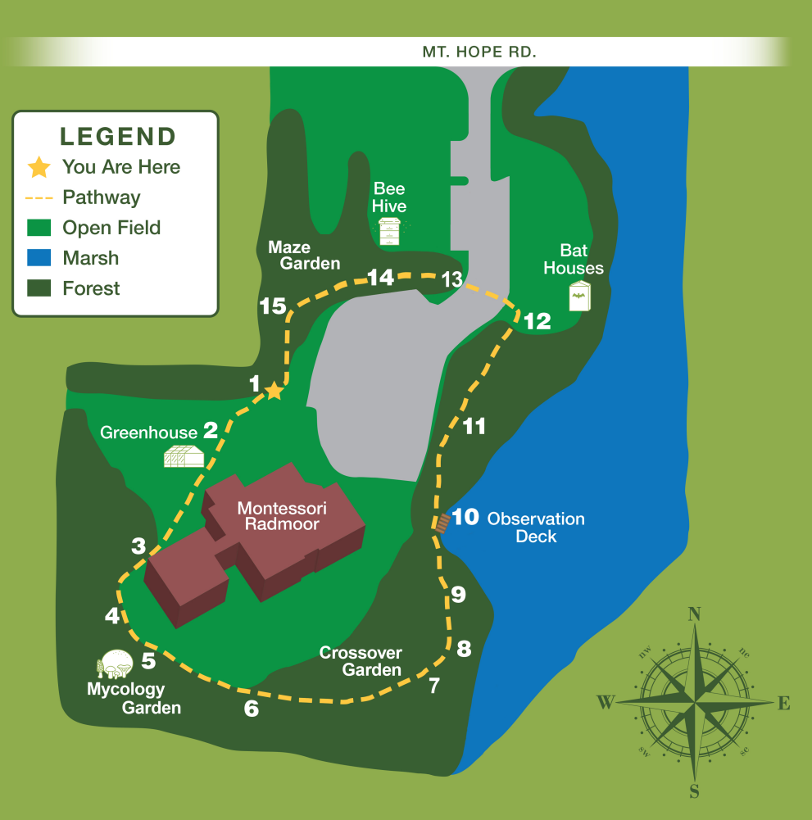
WHAT IS THE PATHWAY TO DISCOVERY?
Nature trail that encircles the property
15 Interpretive signs along the way
Solar powered trail cameras that capture wildlife

Slide 5

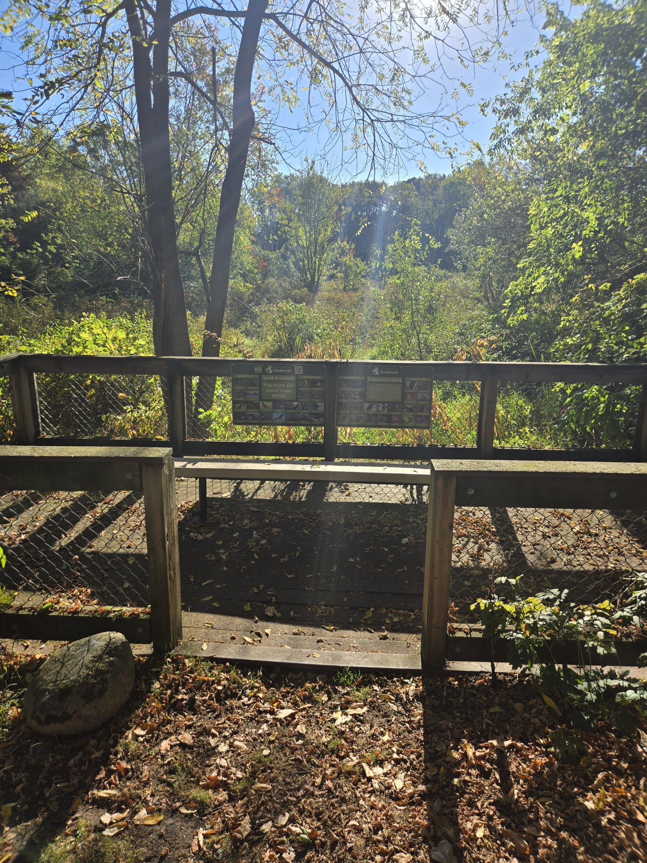
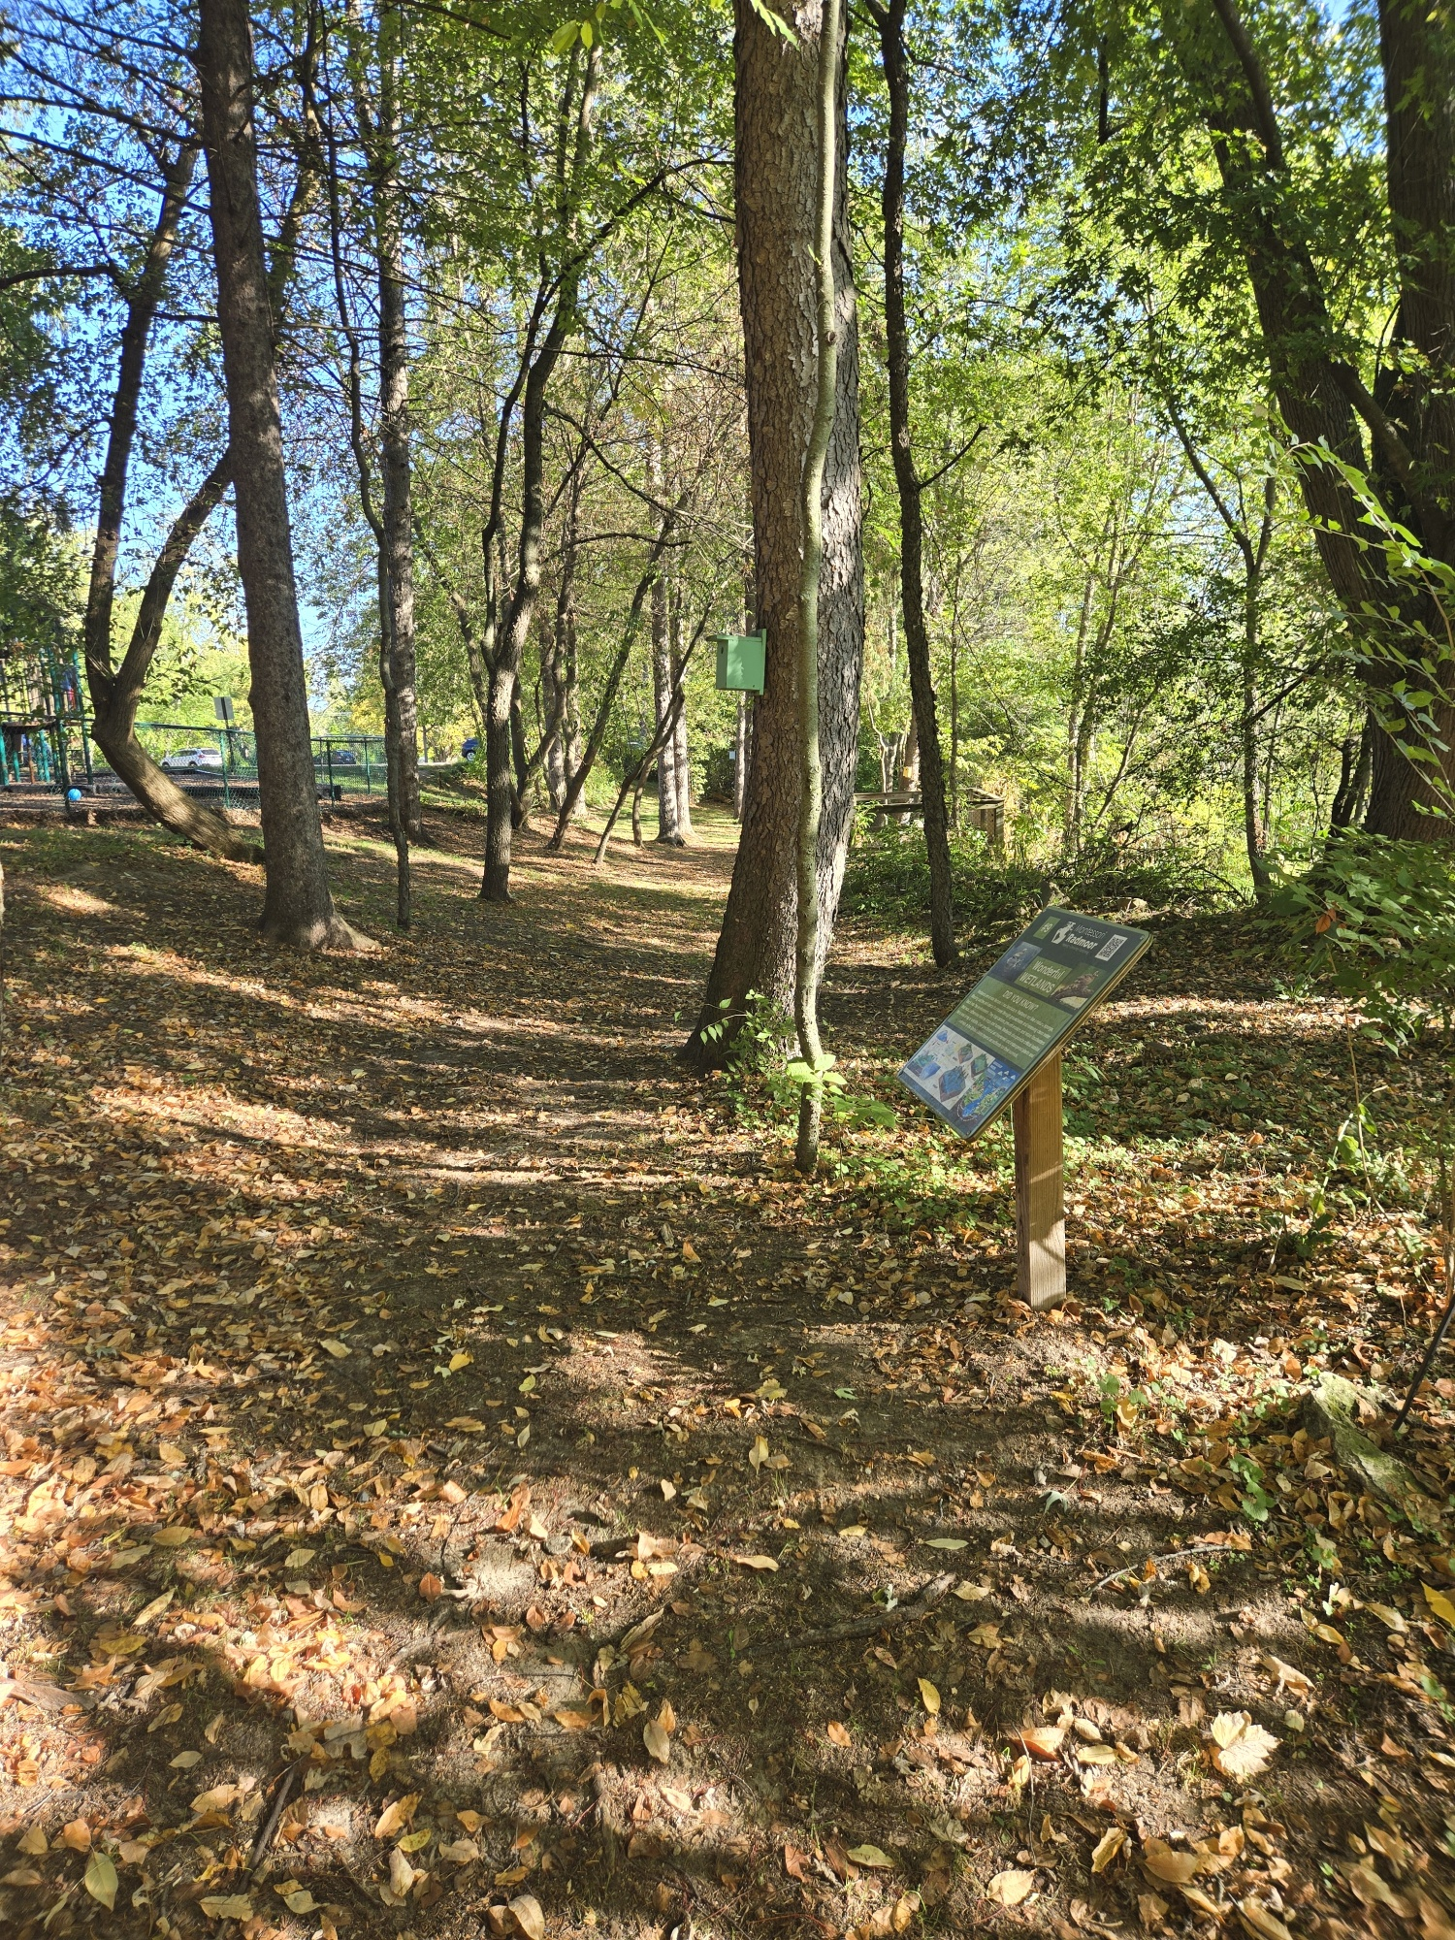
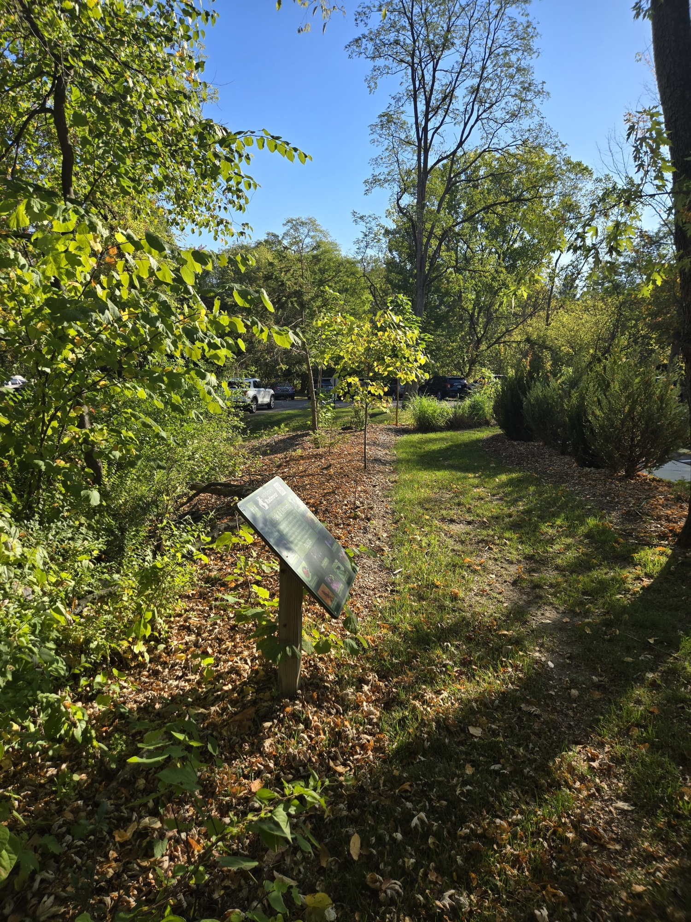
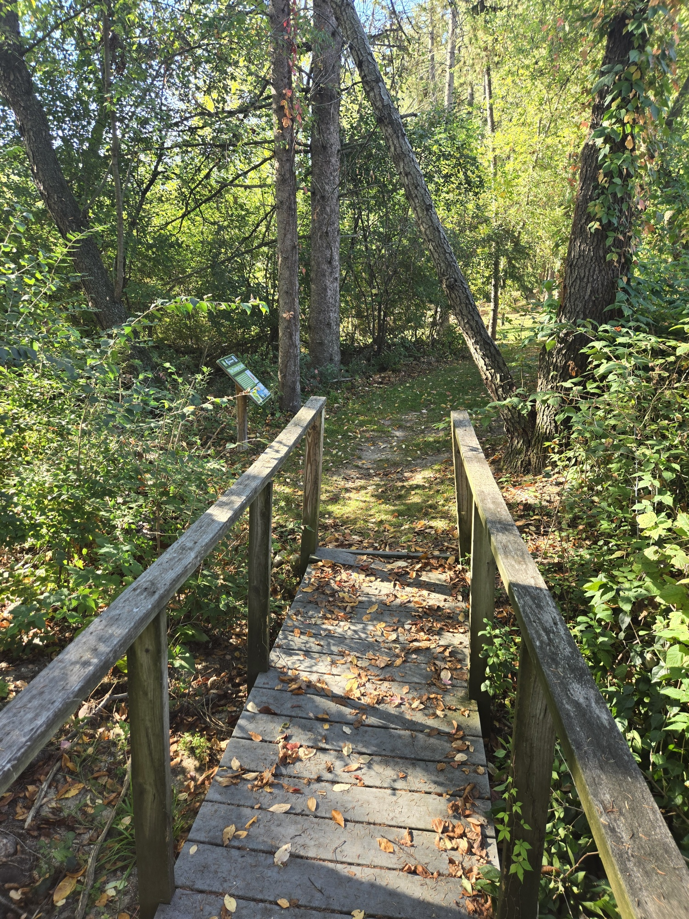
Beneficial Bugs
Sign
Changing Land
Sign
Wetland Sign
Observation Deck
(Bird Signs)

Slide 6
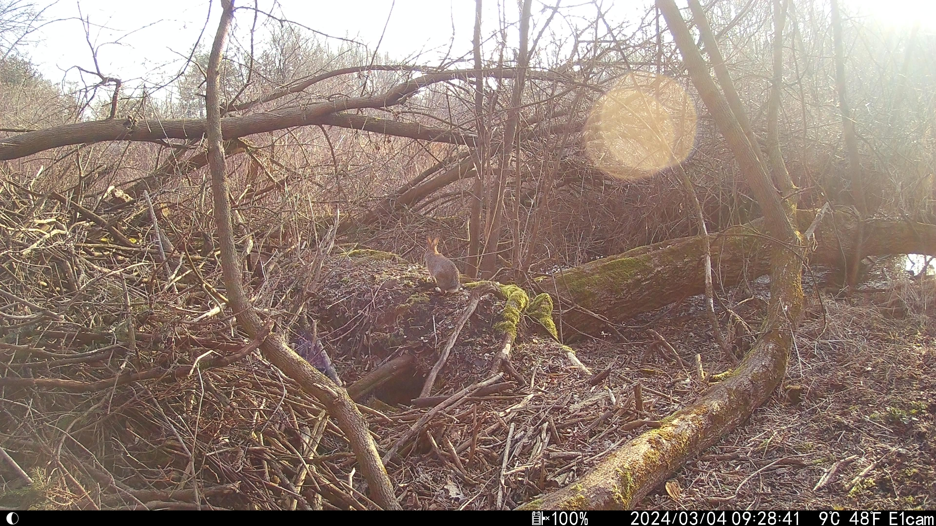
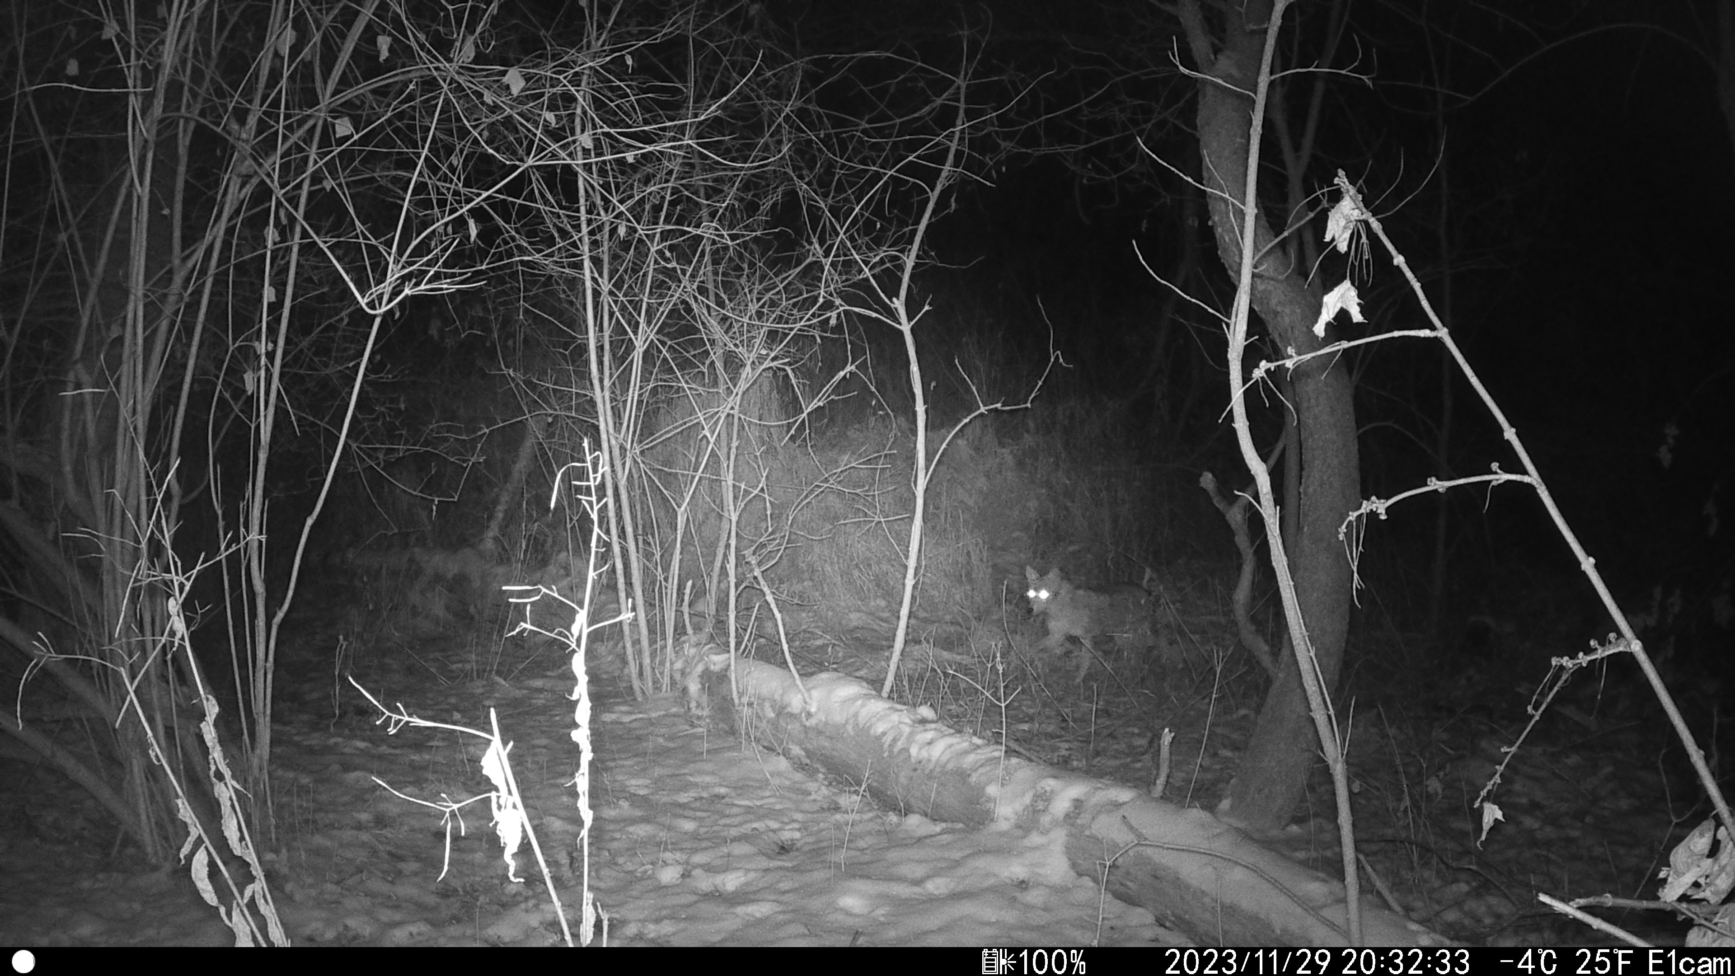
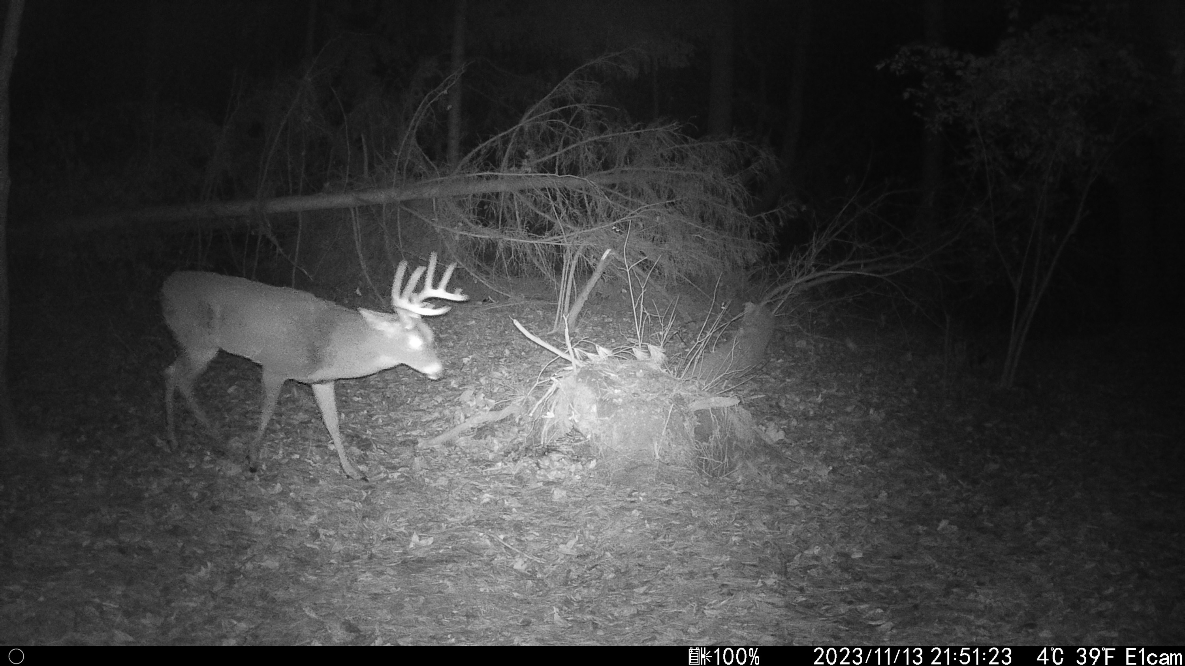
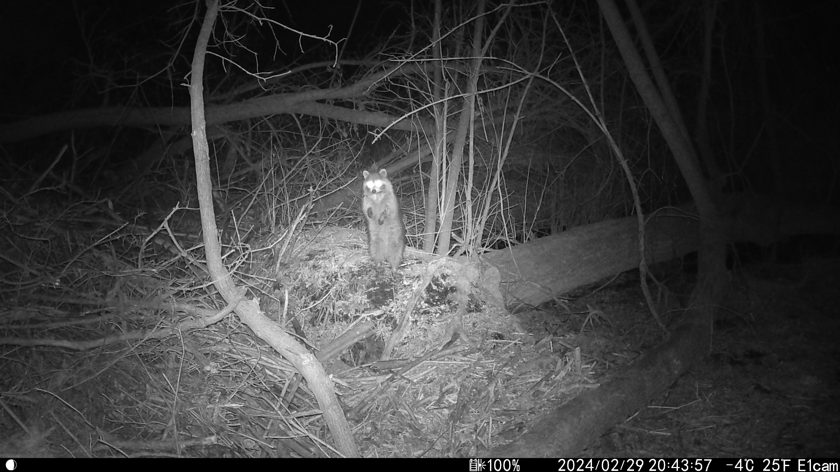
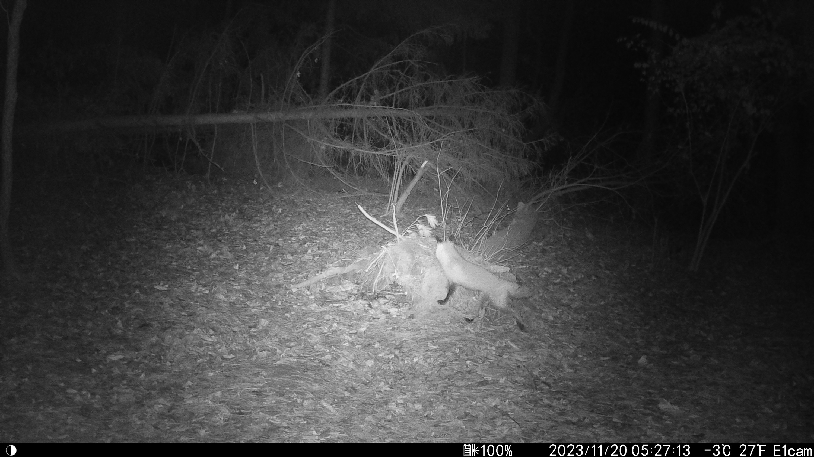
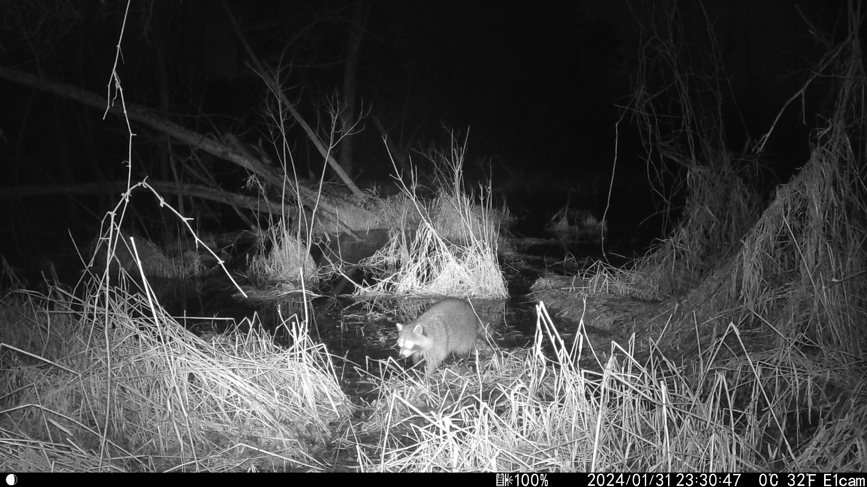
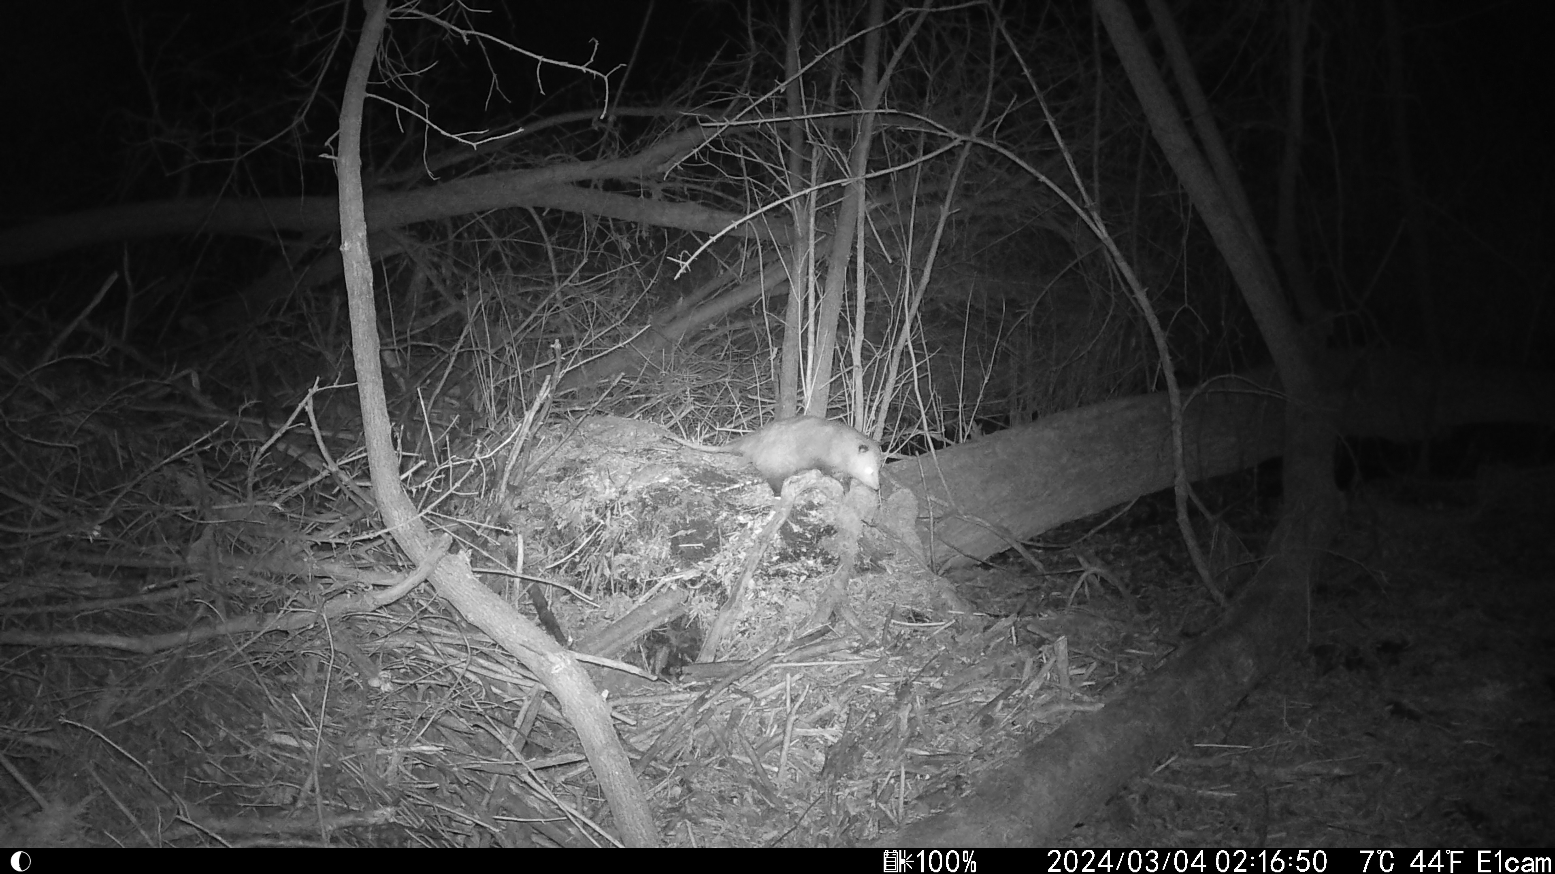

Slide 7

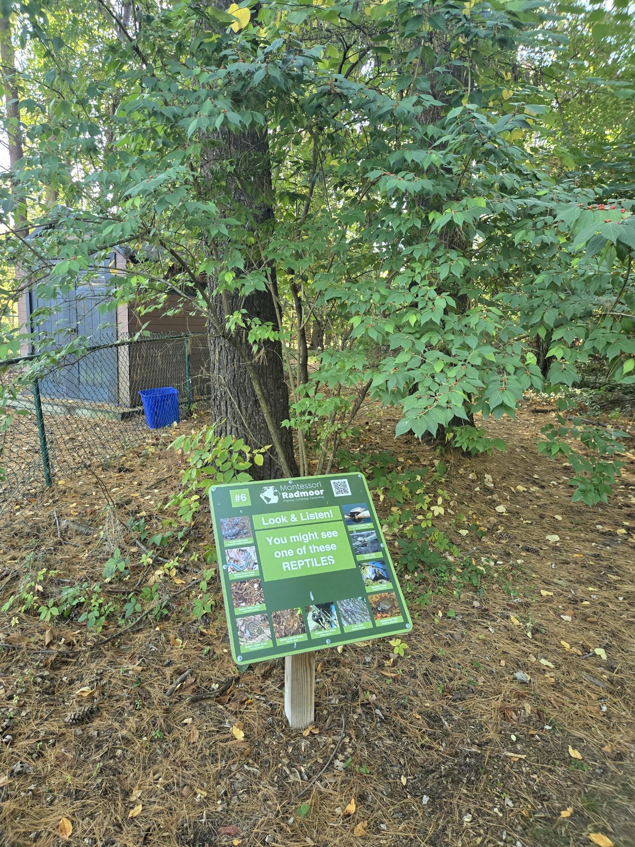

Slide 8

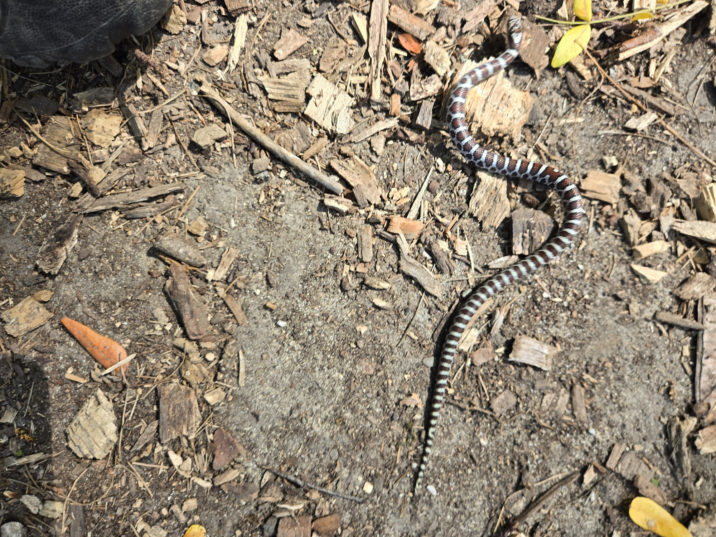
Eastern Milk Snake!!

Slide 9
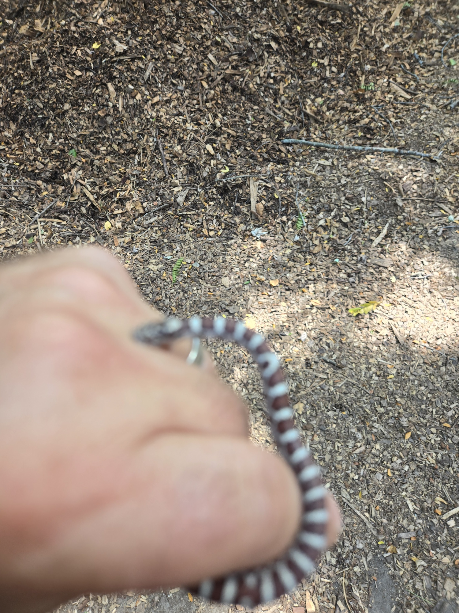
(he bit me)

Slide 10
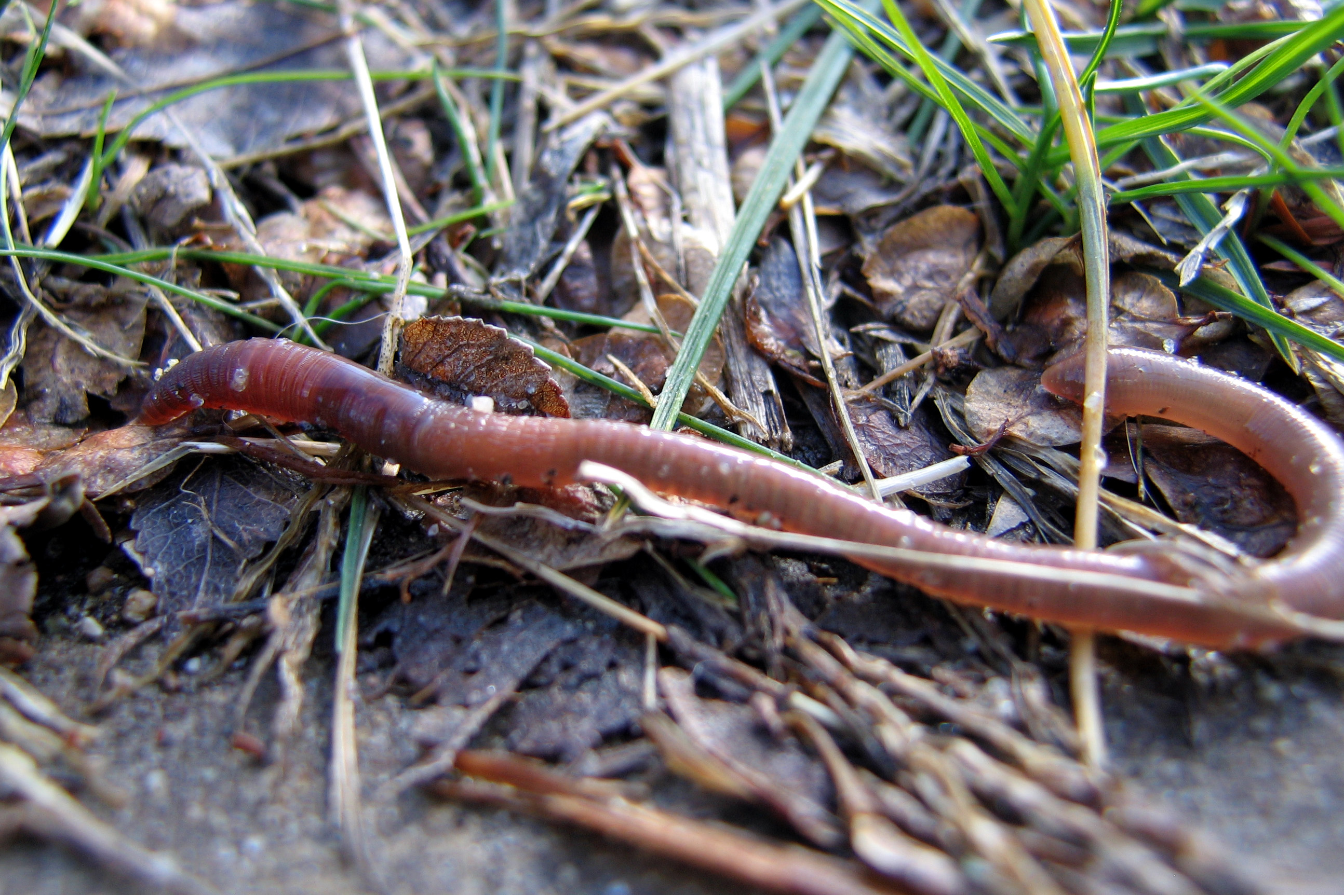

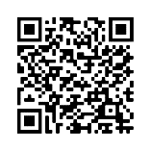
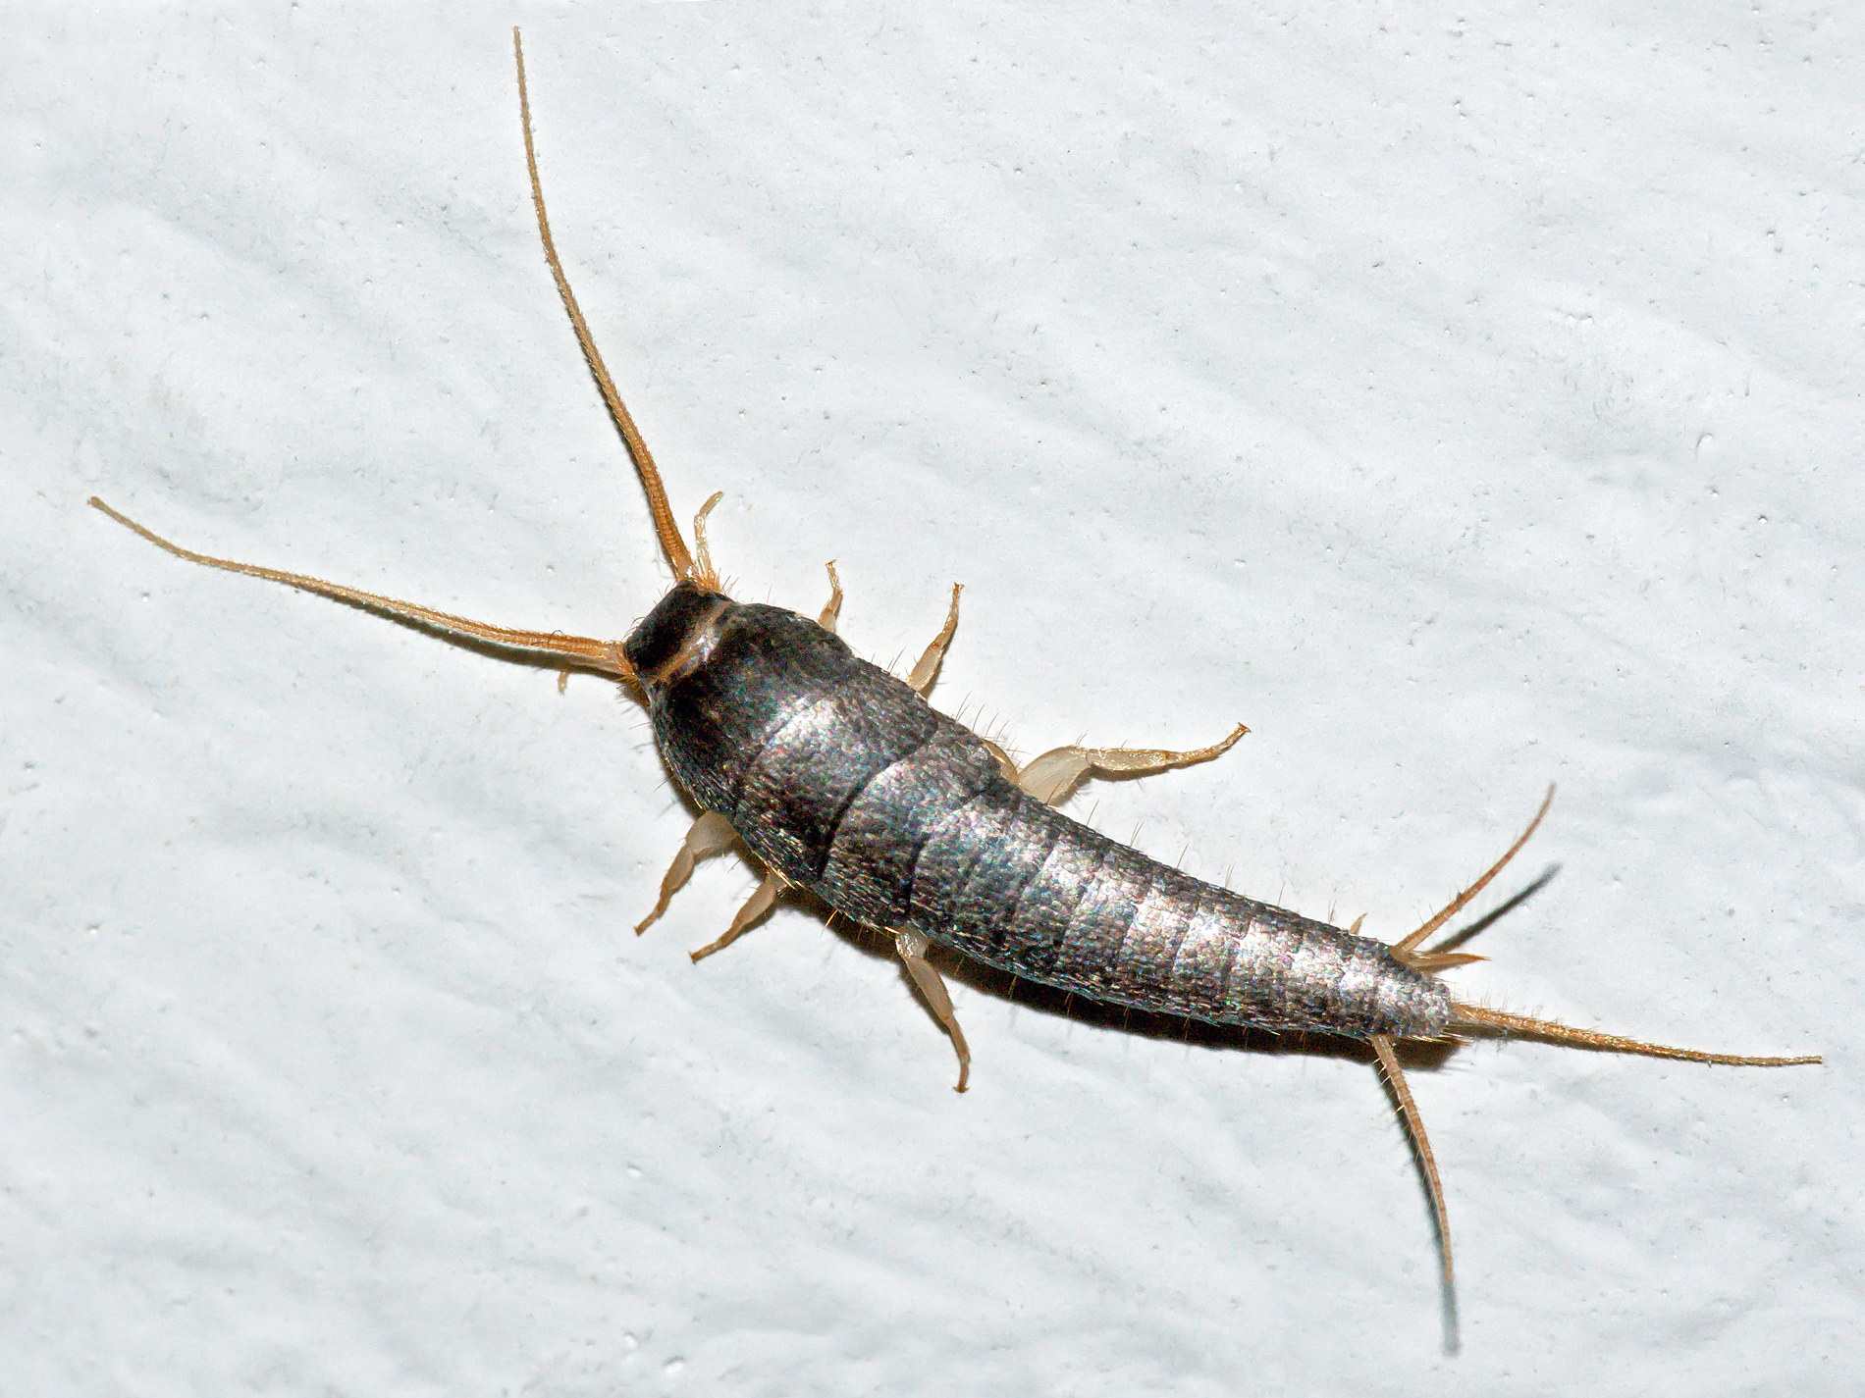
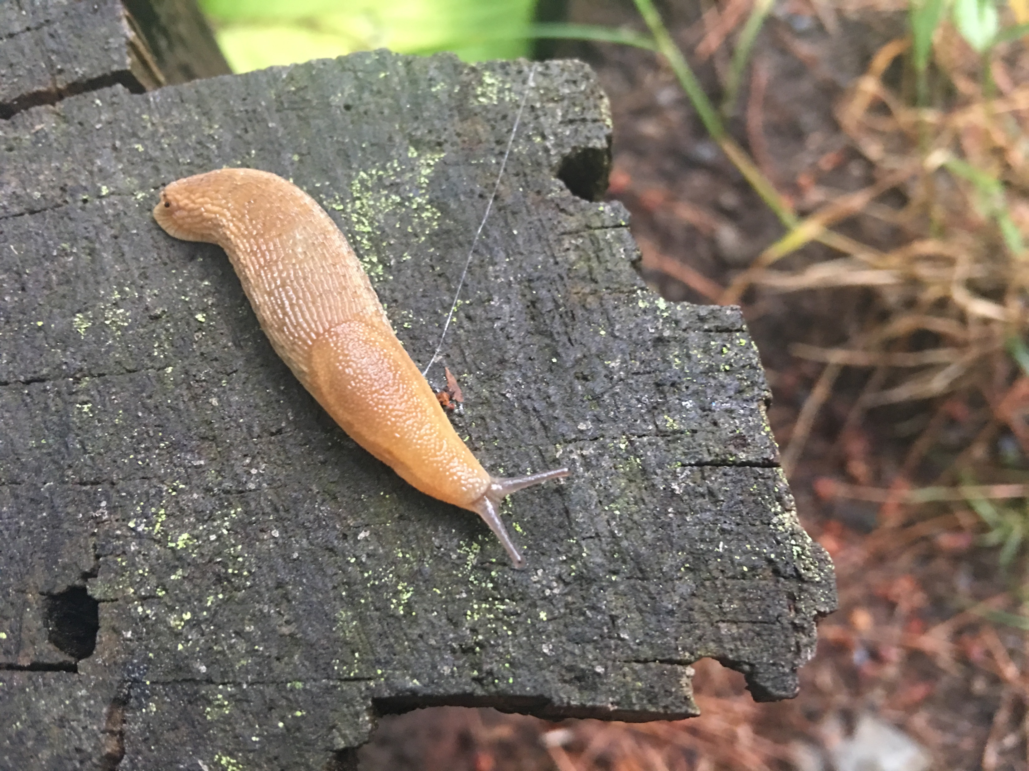
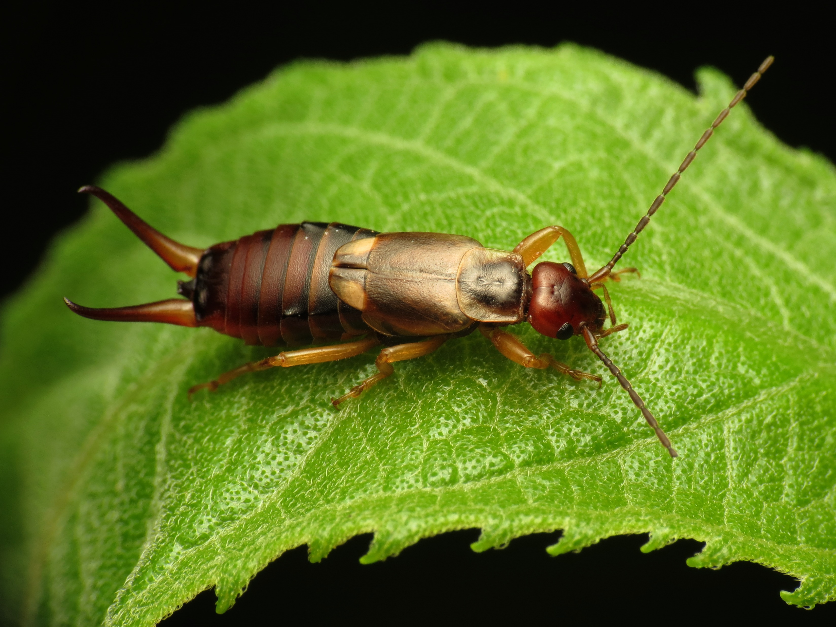
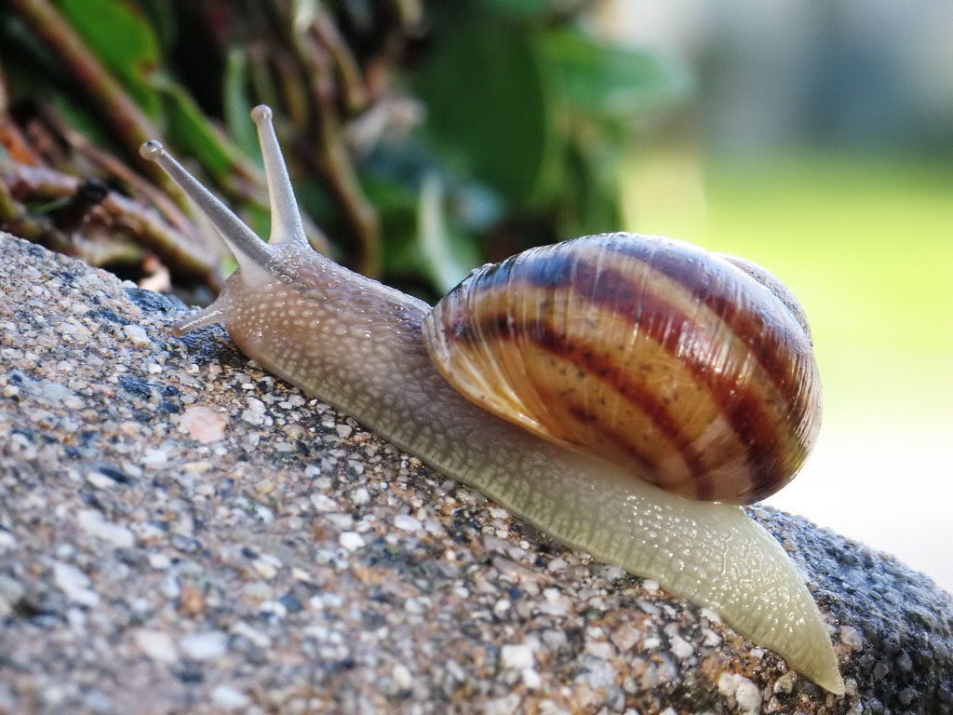
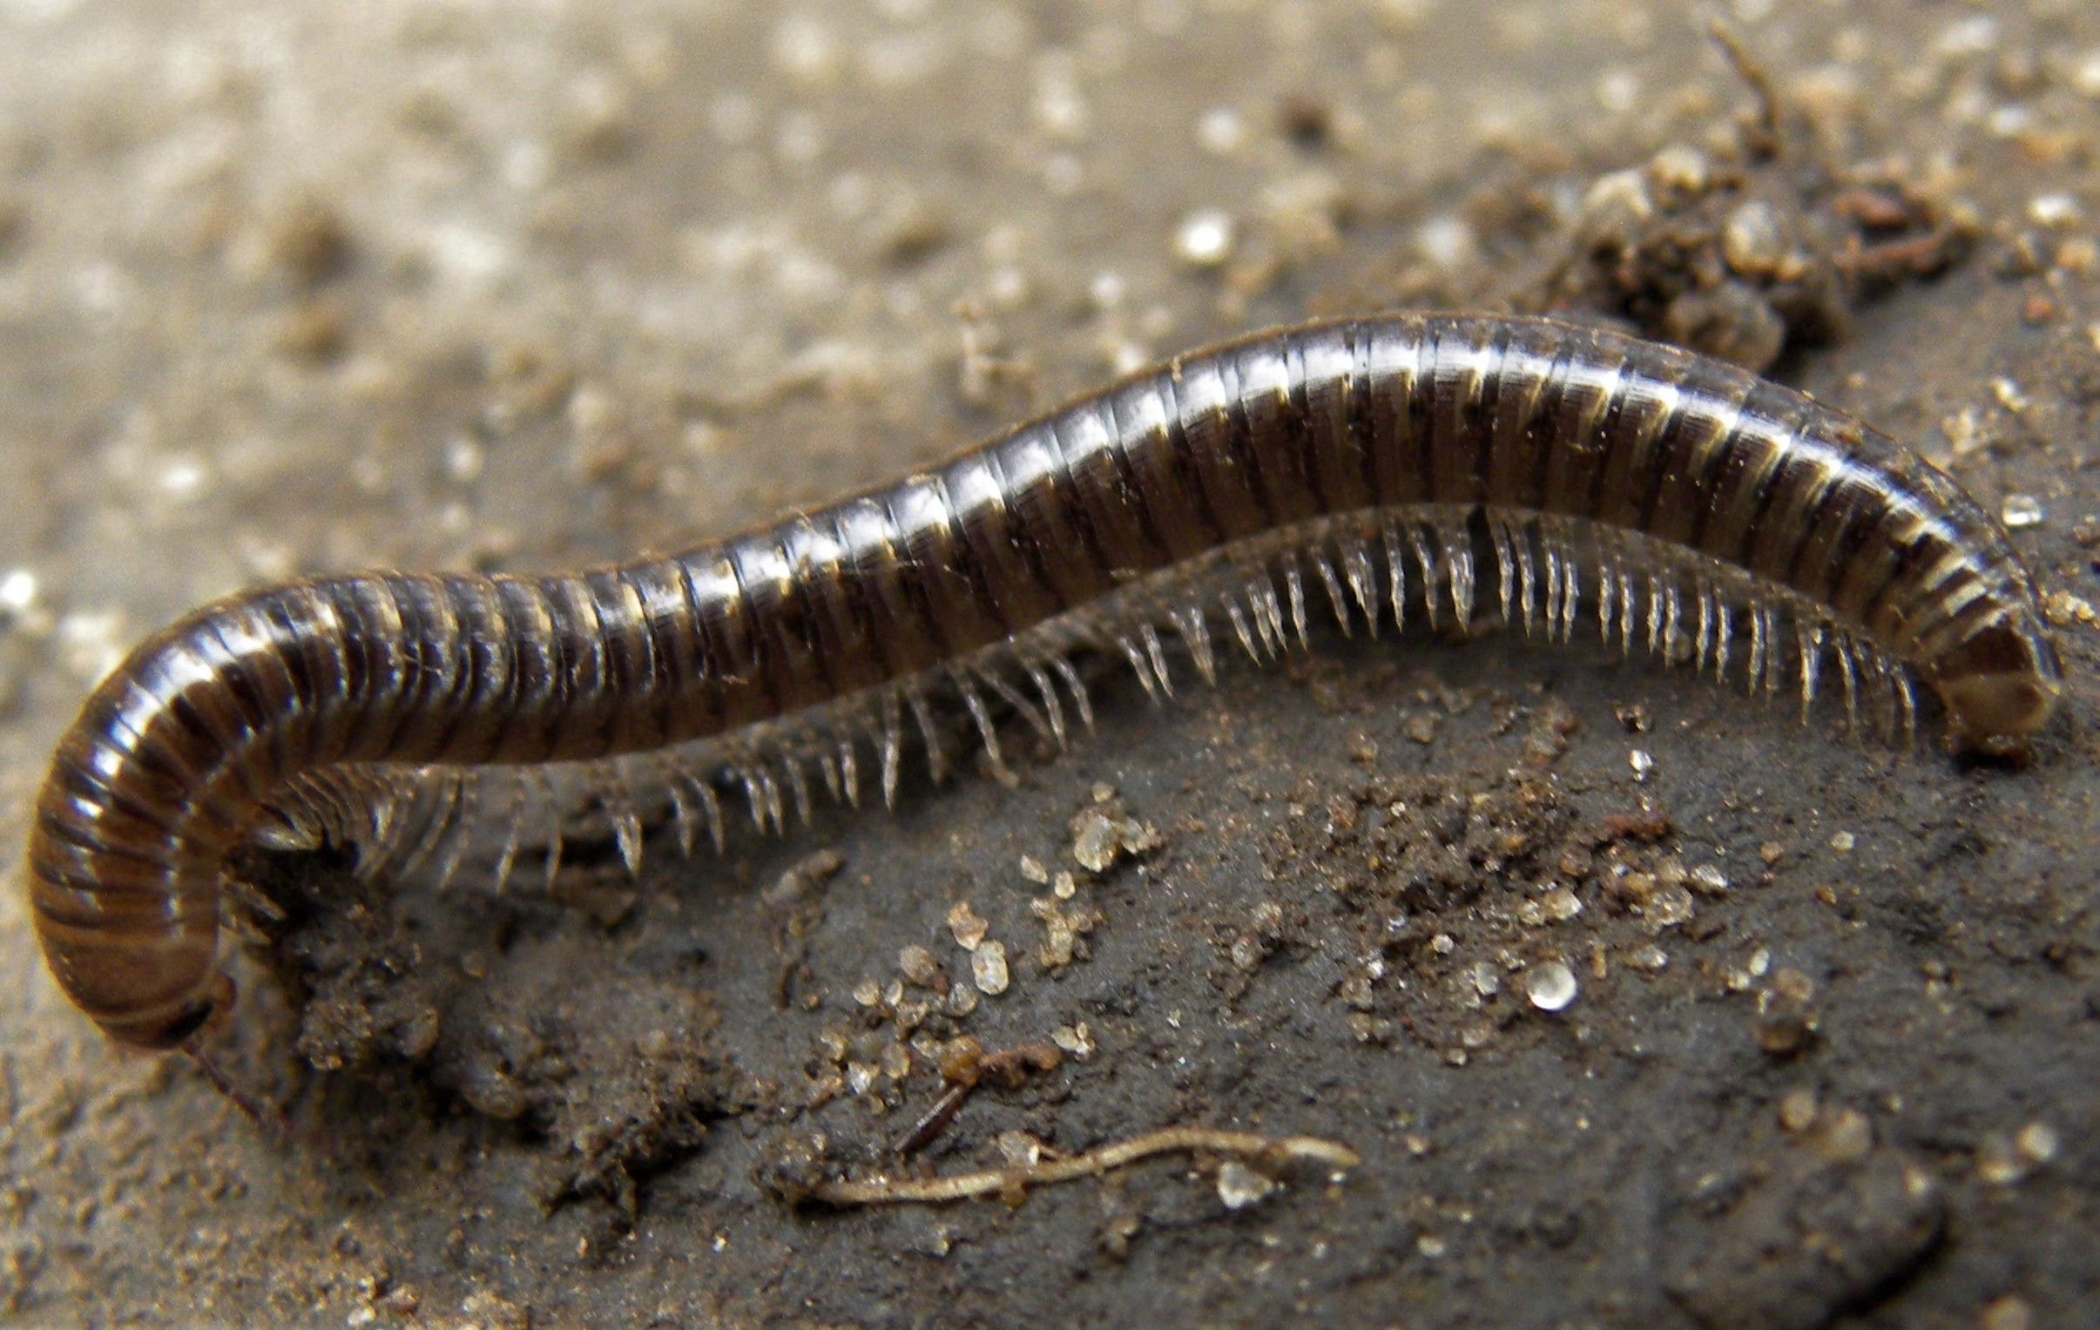
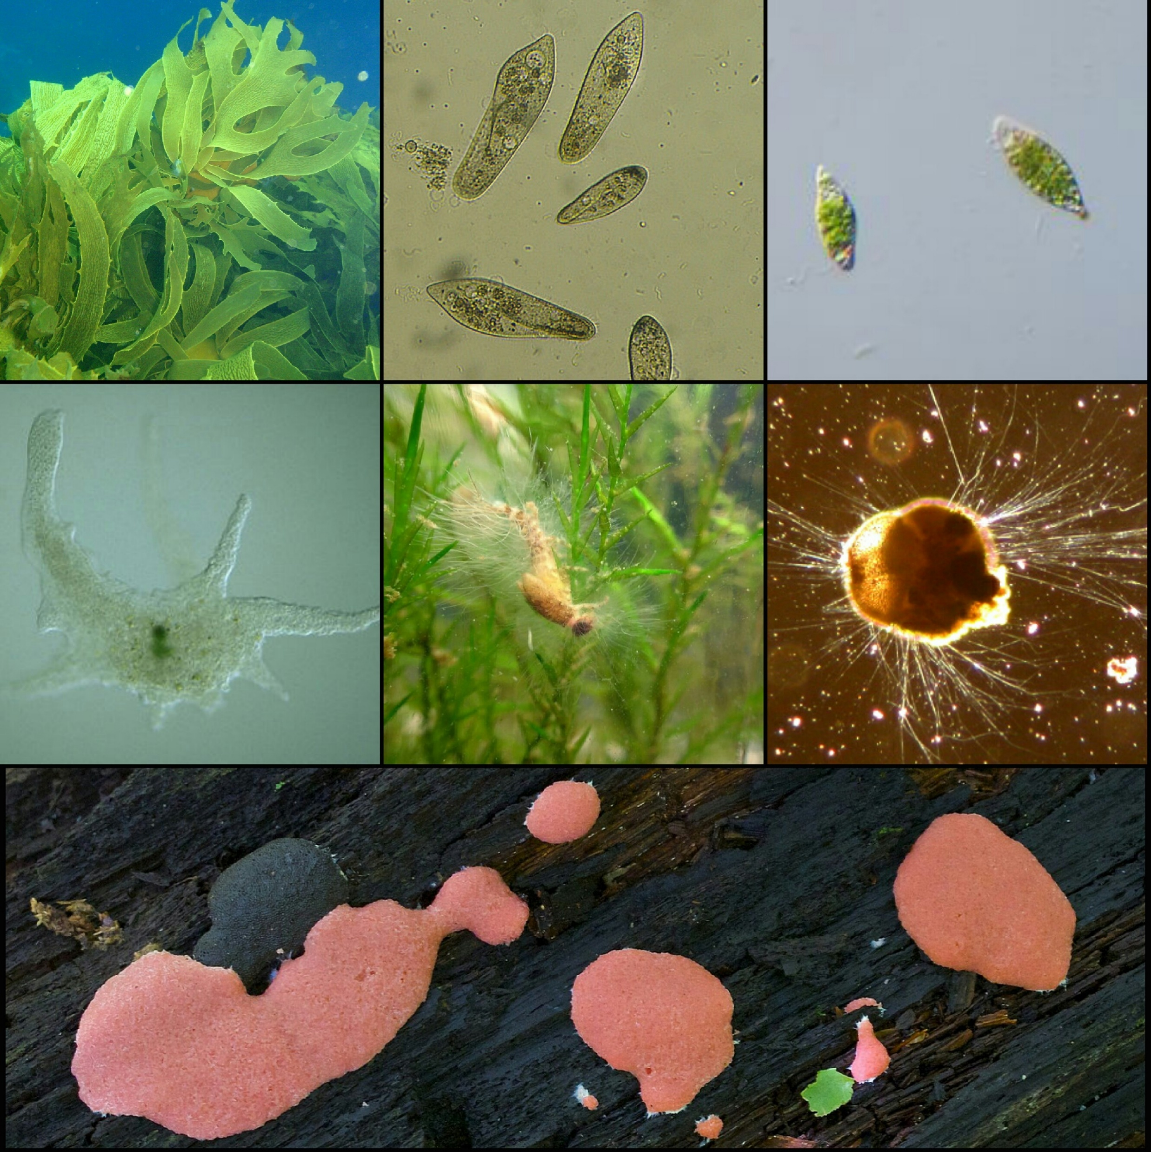
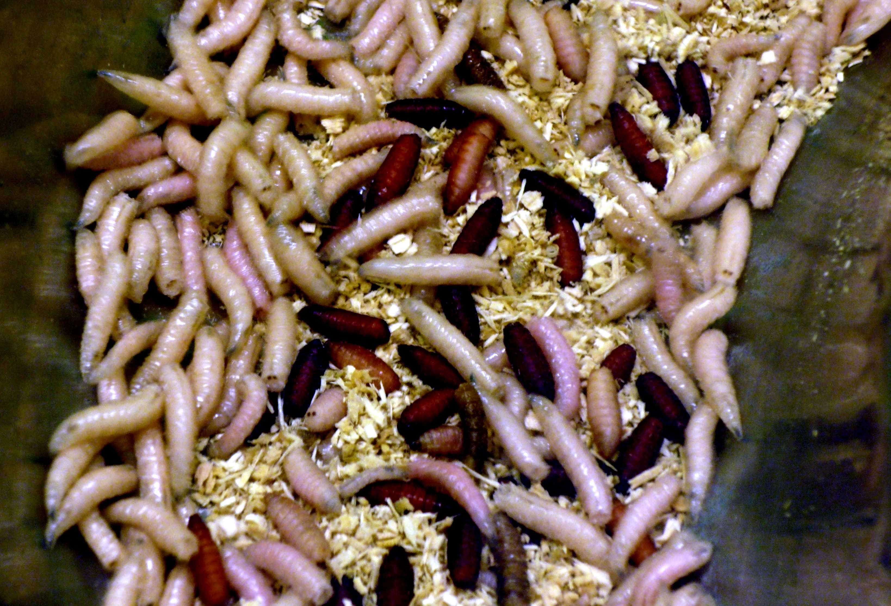
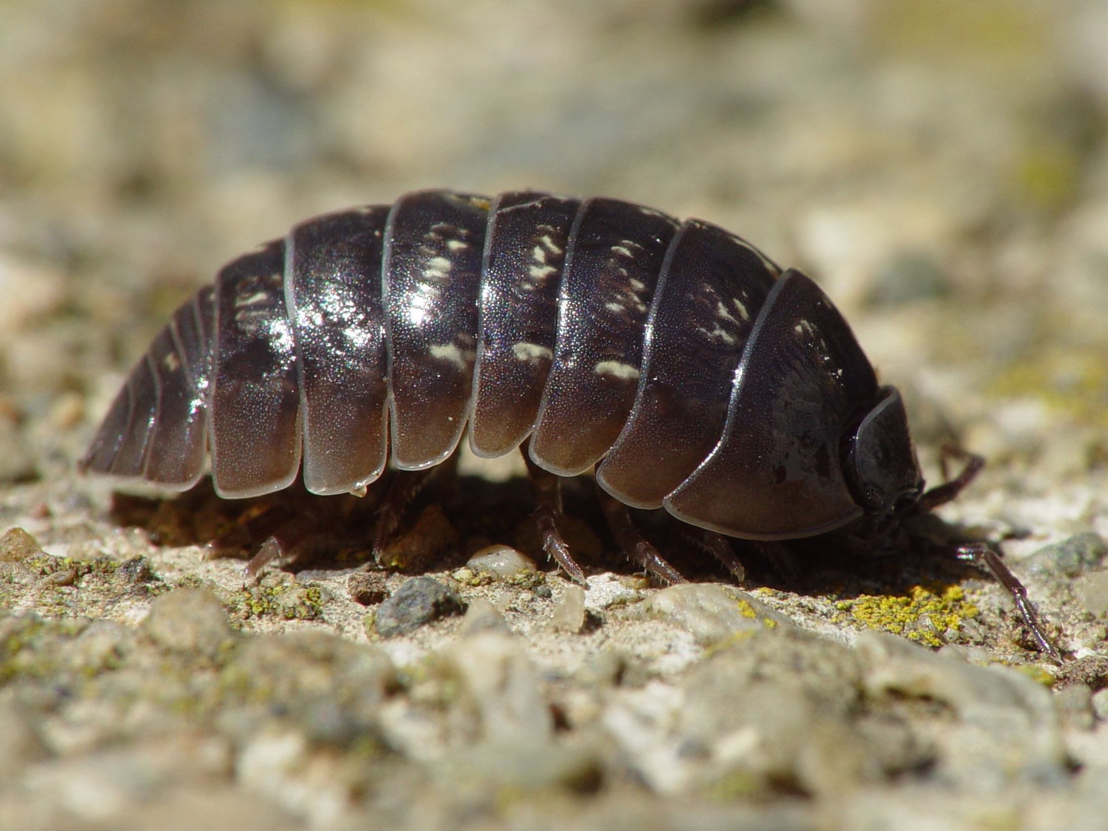
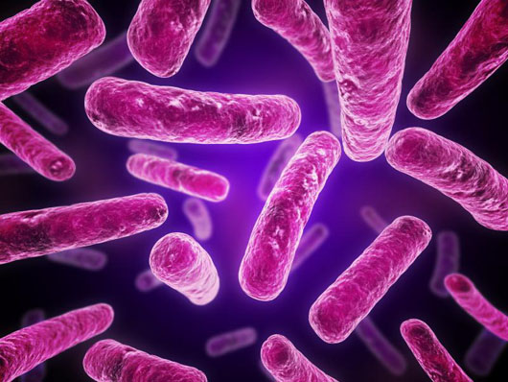
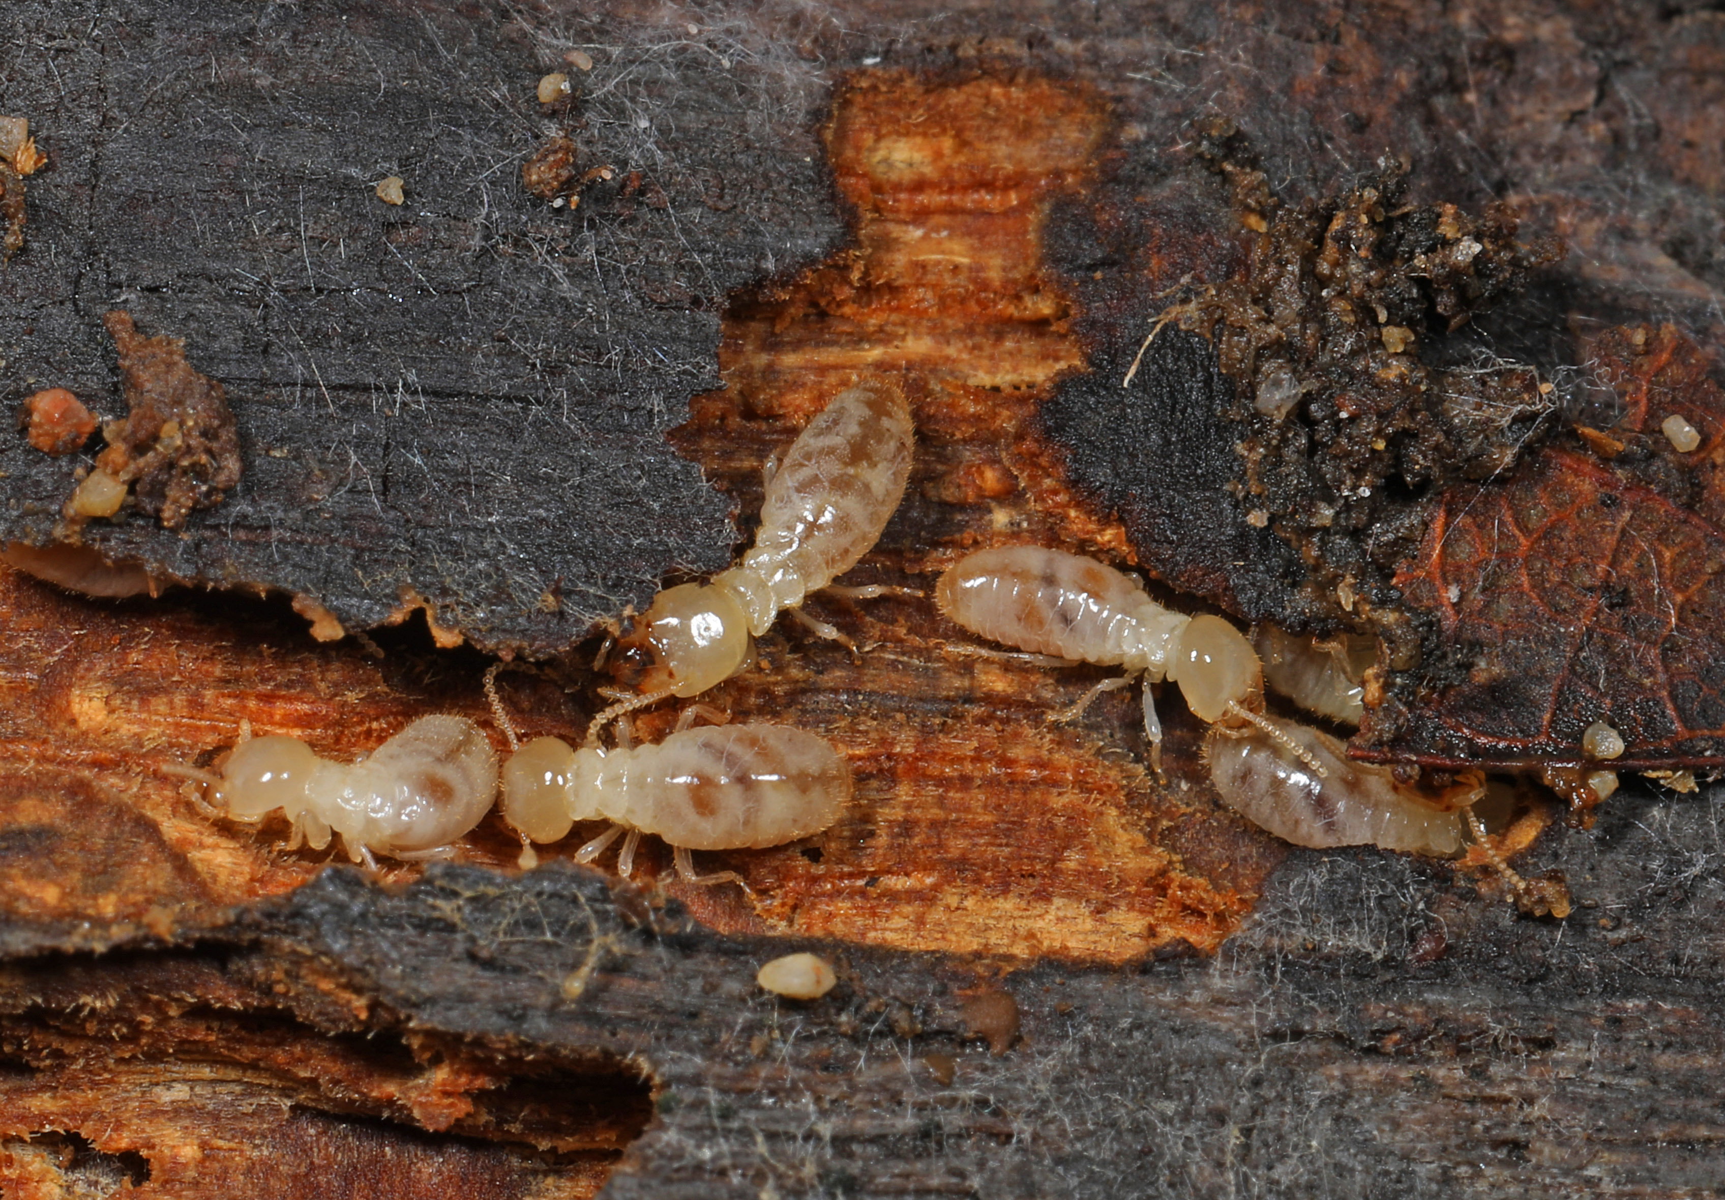
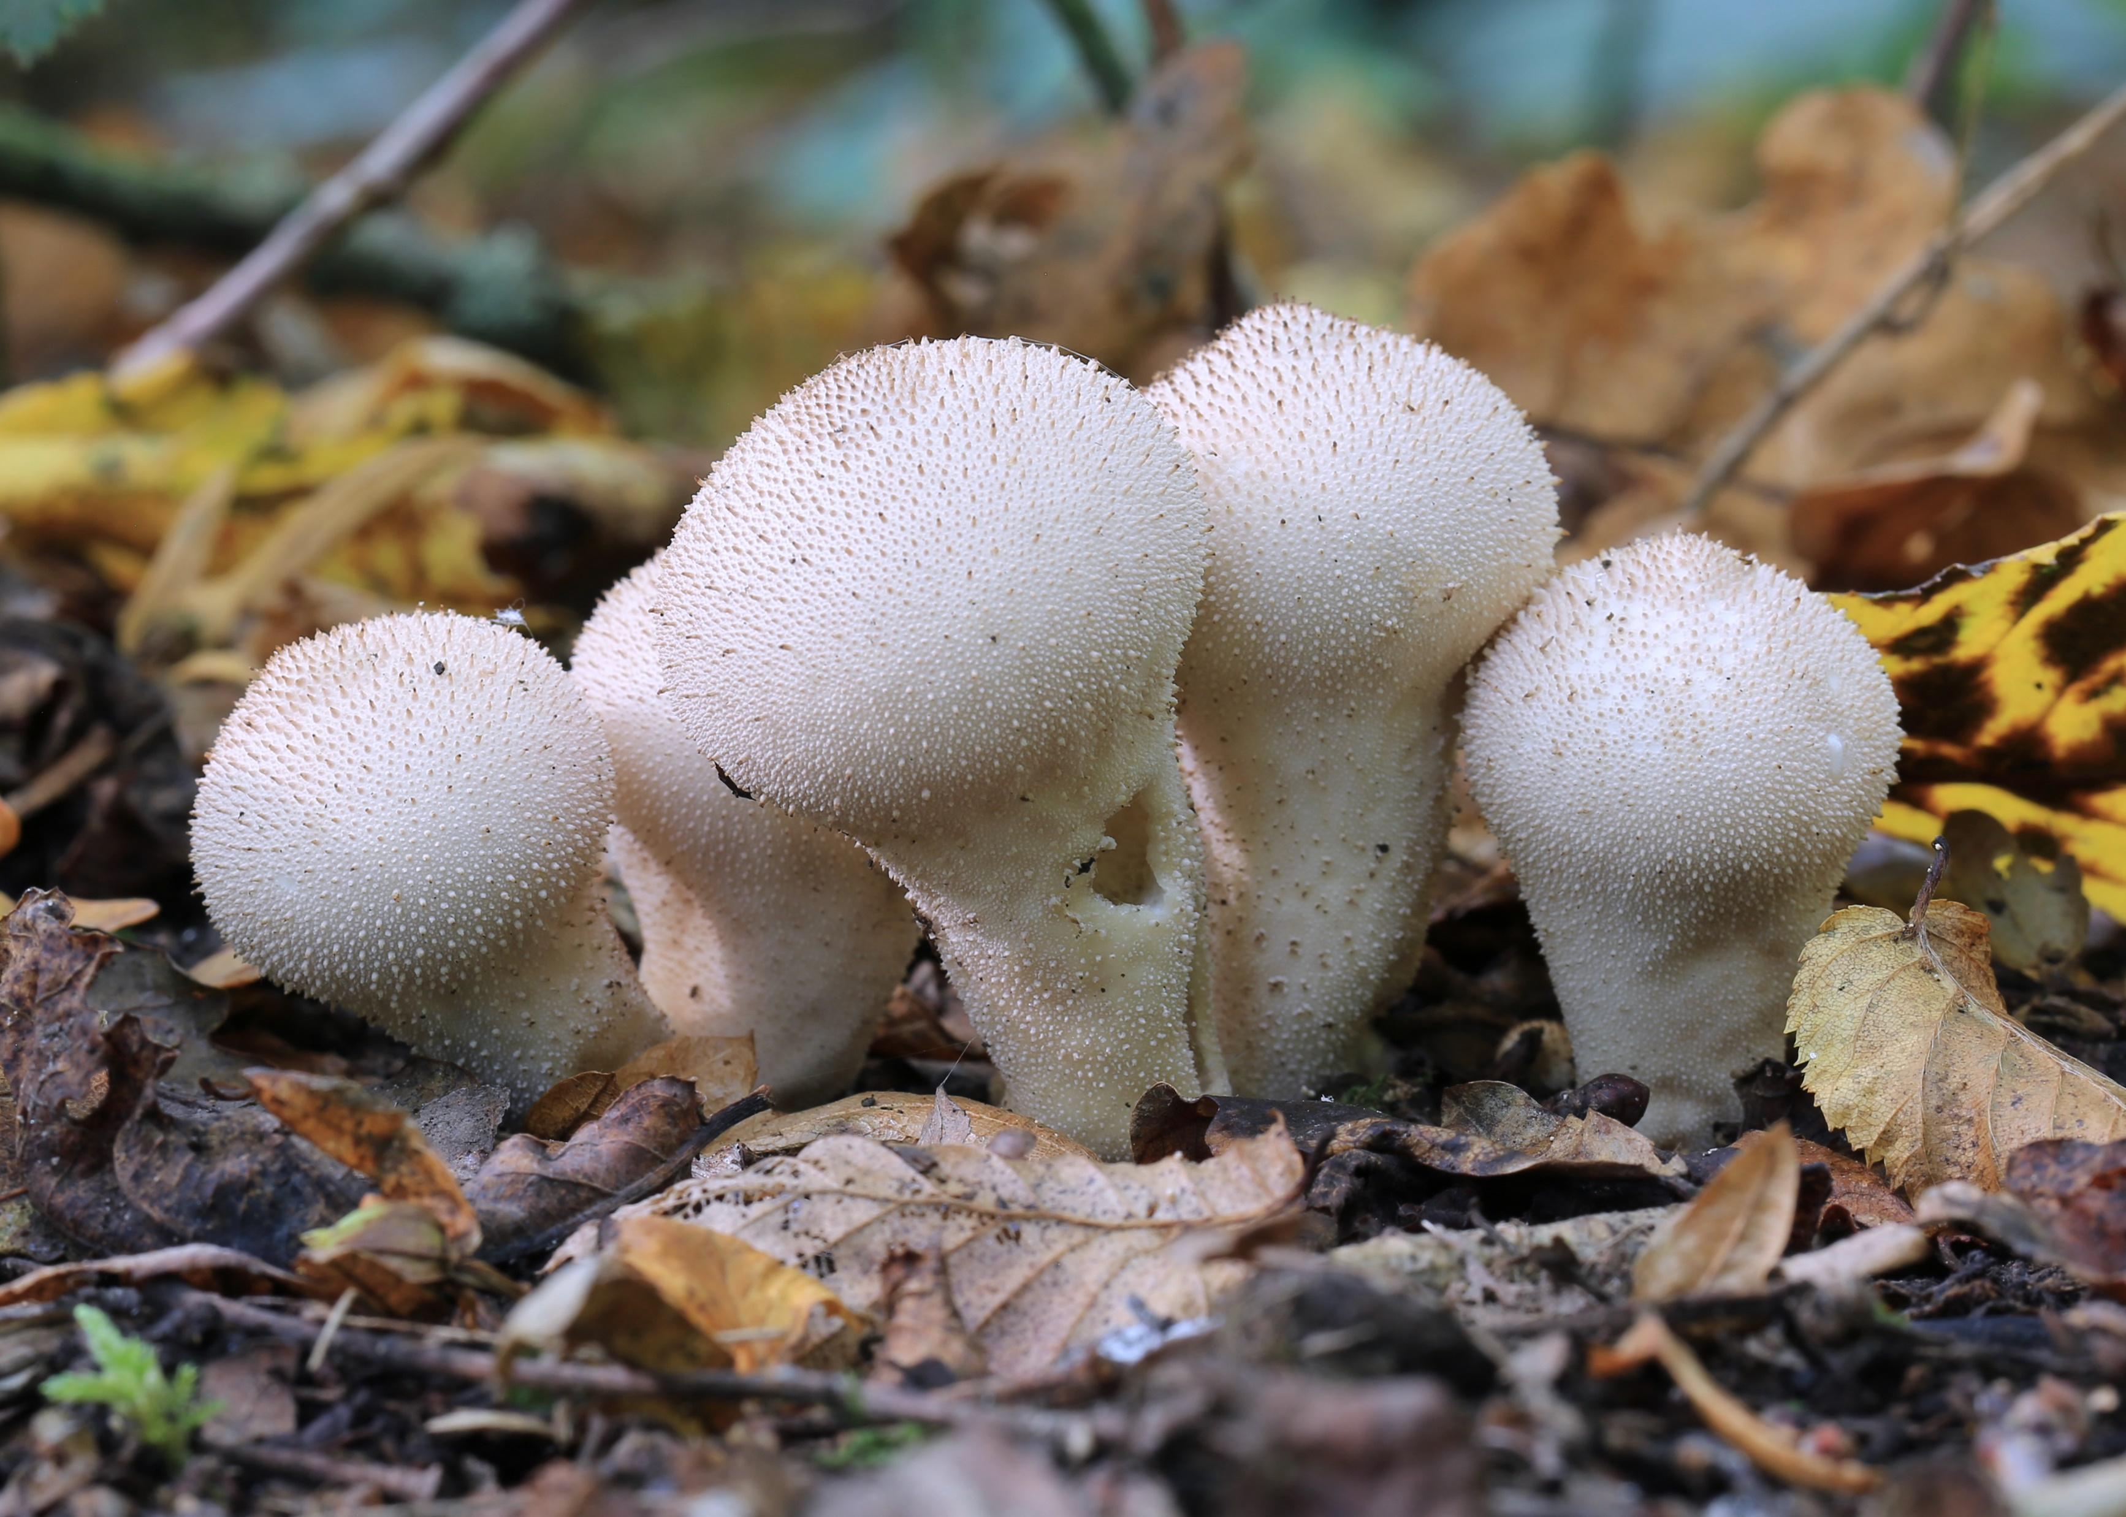
#15
Decomposition
EARTHWORMS
SILVERFISH
When a plant or animal dies decomposers and detritivores break down the organic matter and recycle it back into the living world. Often called “leaf litter”, DETRITUS are small pieces of decaying plants and animals, like dead leaves, logs, and animal remains. Look around and you might see some of these important organisms at work!
DECOMPOSERS do not have mouths and they decay (break down, degrade) detritus by secreting enzymes externally and absorbing the nutrients. Fungi and bacteria are decomposers.
DETRITIVORES have mouths and eat detritus and degrade organic matter internally, excreting nutrients back into the environment. Earthworms and millipedes are detritivores.
SLUGS
EARWIGS
SNAILS
MILLIPEDES
PROTISTS
MAGGOTS
PILLBUGS
BACTERIA
TERMITES
FUNGI

Slide 11
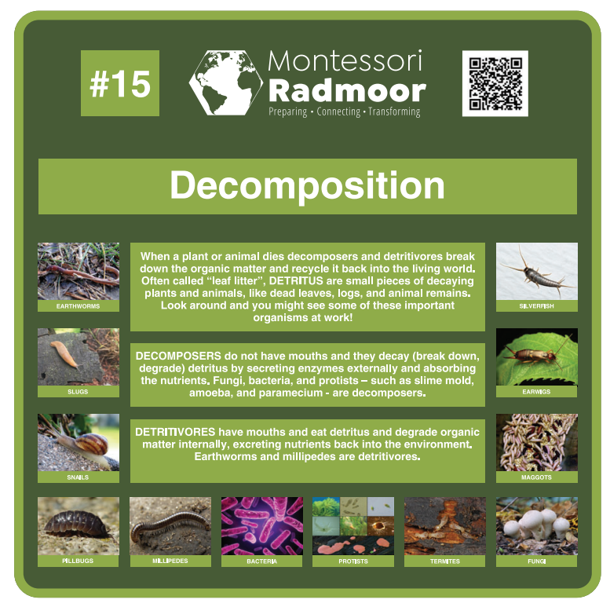

Slide 12
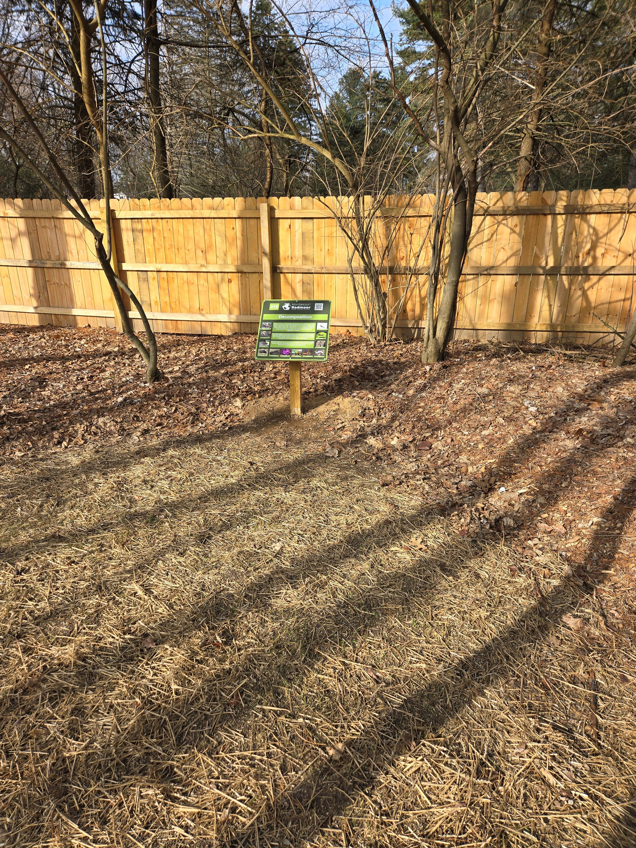
New Decomposition Sign Along the Pathway!

Slide 13
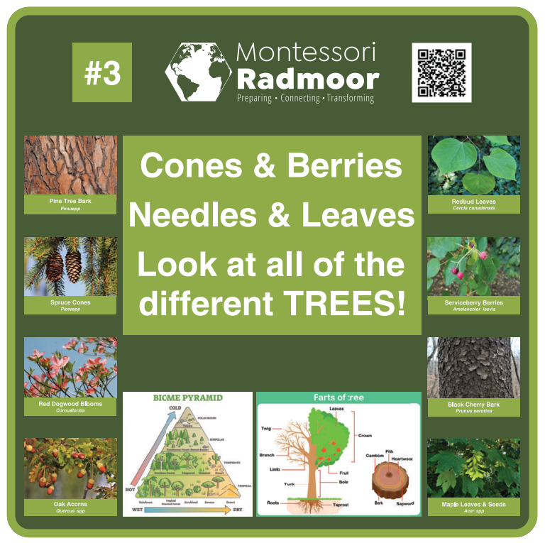

Slide 14
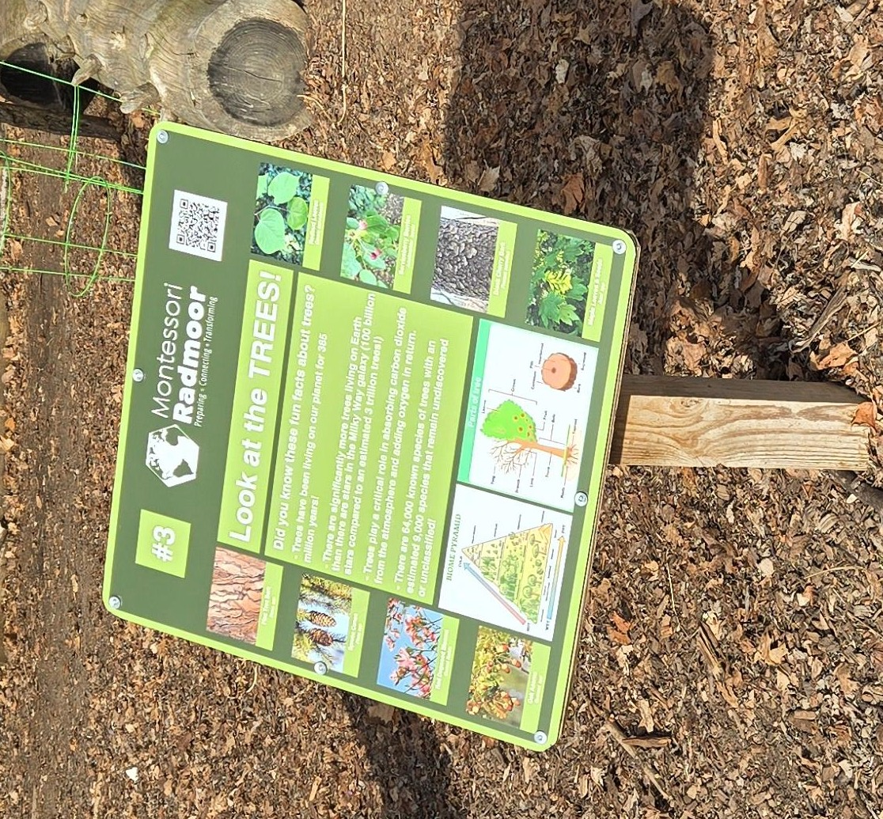
Replacement of
damaged tree sign
with new facts!

Slide 15
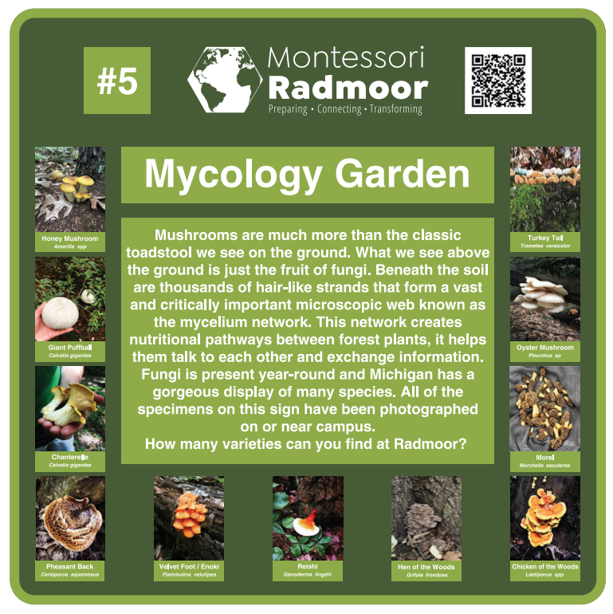

Slide 16
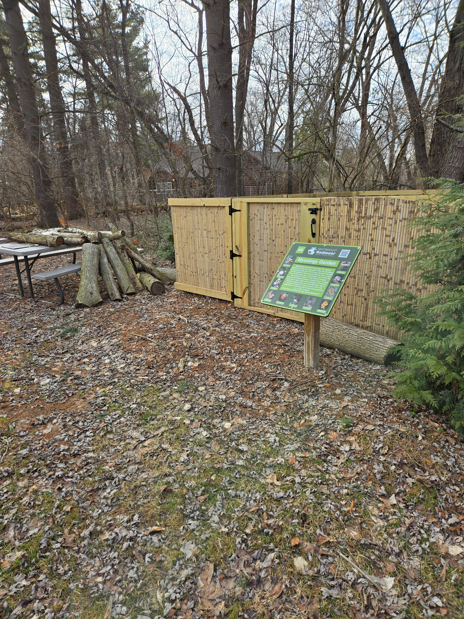
Our new mycology sign
and
enclosed garden!

Slide 17

Follow The Pathway!
Radmoor students have three motion-activated trail cameras that capture the wildlife that share our campus. Scan the QR Code for pictures, videos, and more information on the Pathway to Discovery!
#1
WELCOME TO THE PATHWAY TO DISCOVERY!
The Pathway to Discovery is Montessori Radmoor’s interpretive nature trail that explores the 3 distinct ecosystems of our campus and the plants, wildlife, and natural processes that are within it.
Welcome!
Serra Calda Greenhouse
Look at the TREES
Look & Listen! MAMMALS
Mycology Garden
Look & Listen! REPTILES
Compost & Brush Piles
Look & Listen! AMPHIBIANS
Wonderful Wetlands
Look & Listen! BIRDS
Changing Land
Beautiful BATS
Importance of Pollination
Look & Listen! BUGS
Decomposition

Slide 18
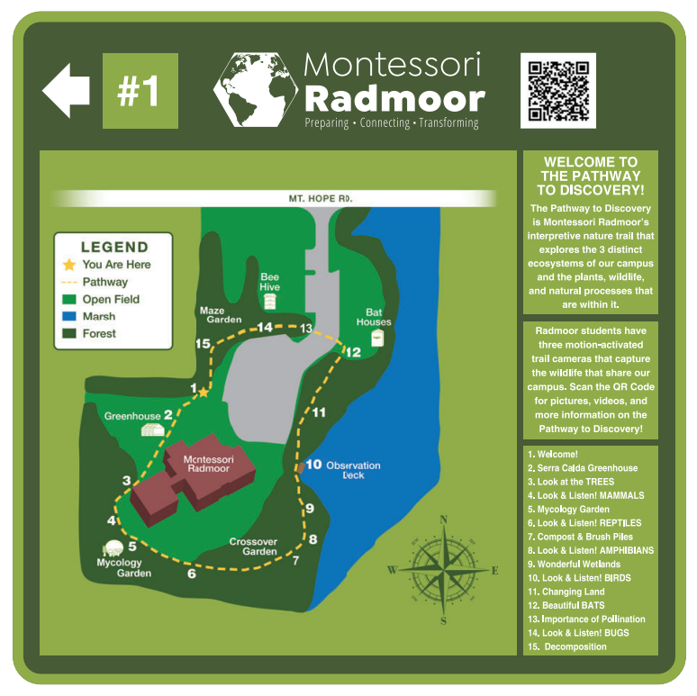

Slide 19
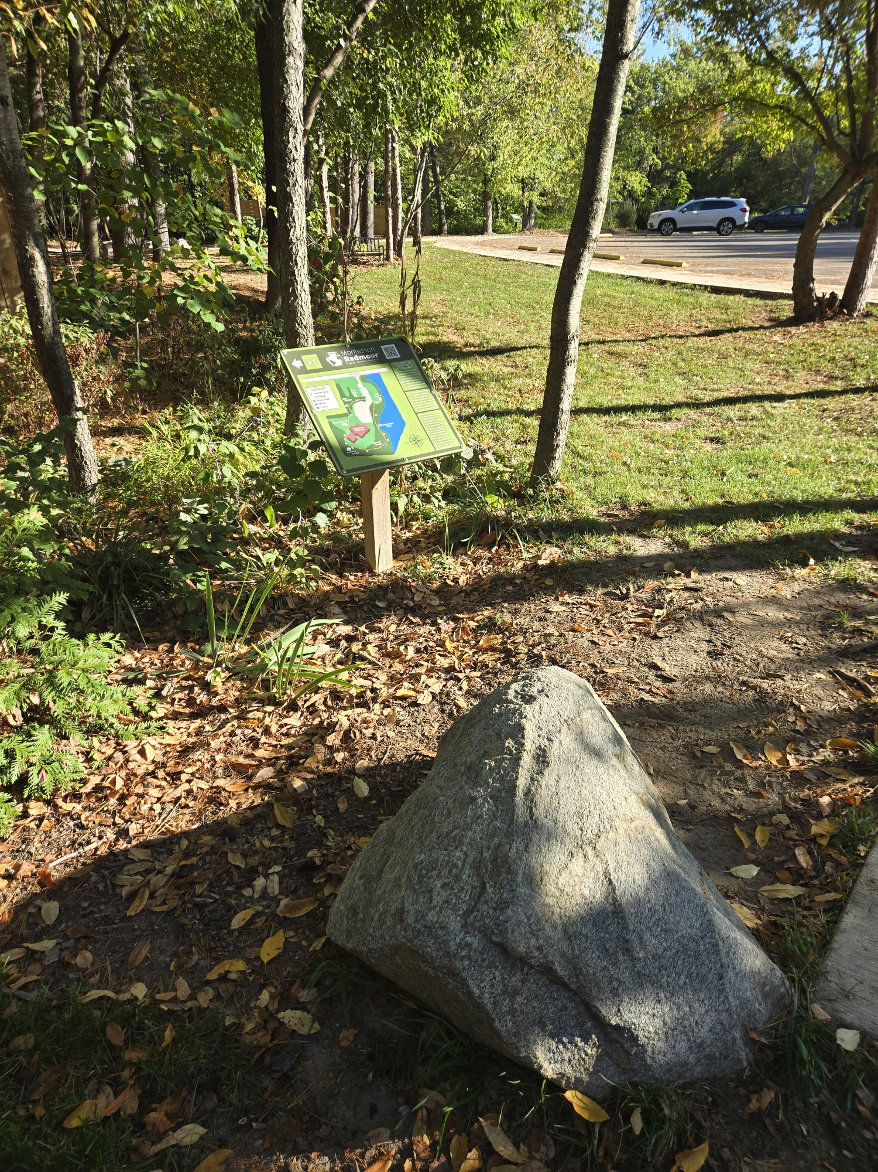
Updated pathway
welcome sign!

Slide 20
PART 2
Funds for Native Plants

Slide 21
- Replace invasives like
Buckthorn, Bush Honeysuckle,
Tree of Heaven, and Jet bead
- Replant areas damaged
by storms or dead trees

Slide 22

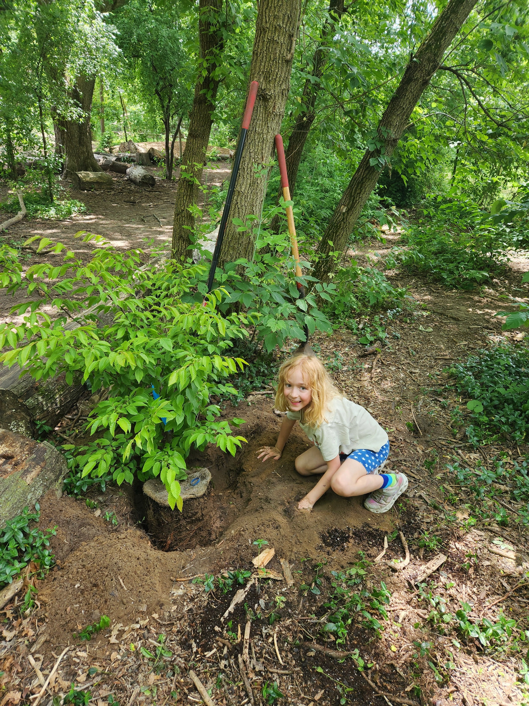
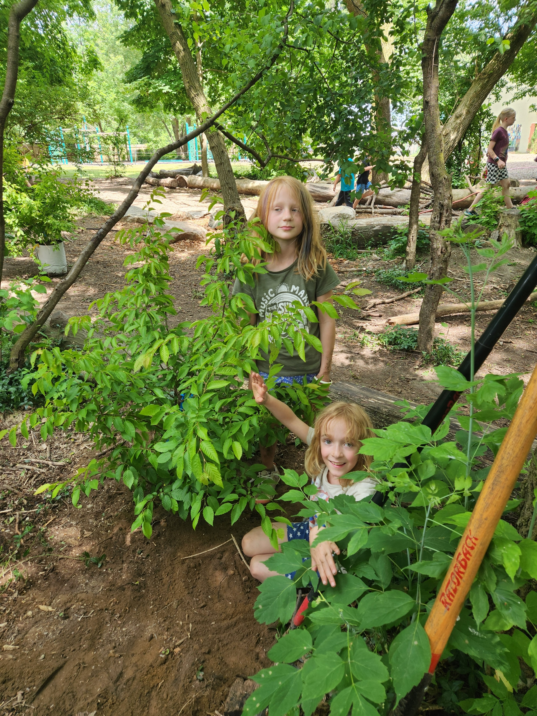
Planting Musclewood (American Hornbeam) Trees!

Slide 23

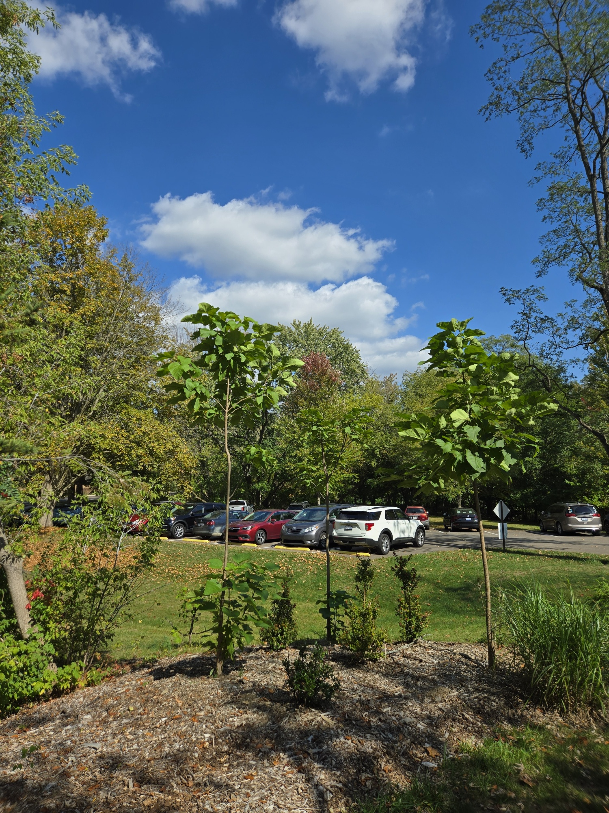
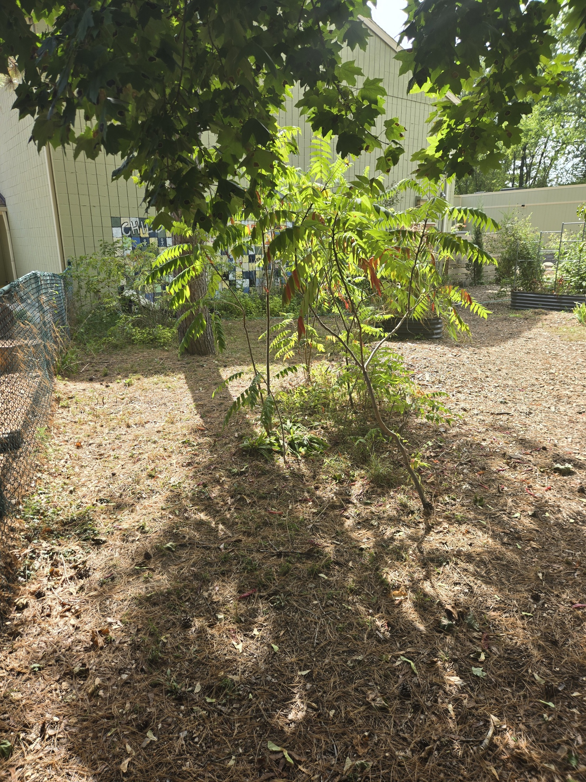
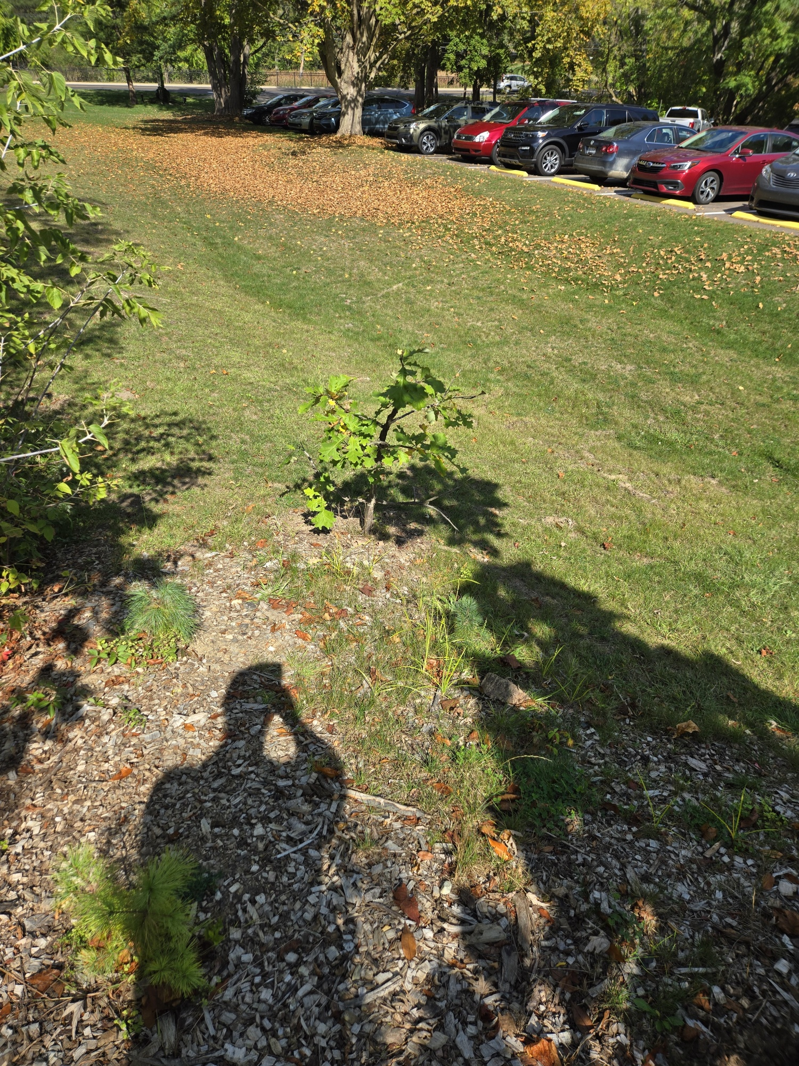
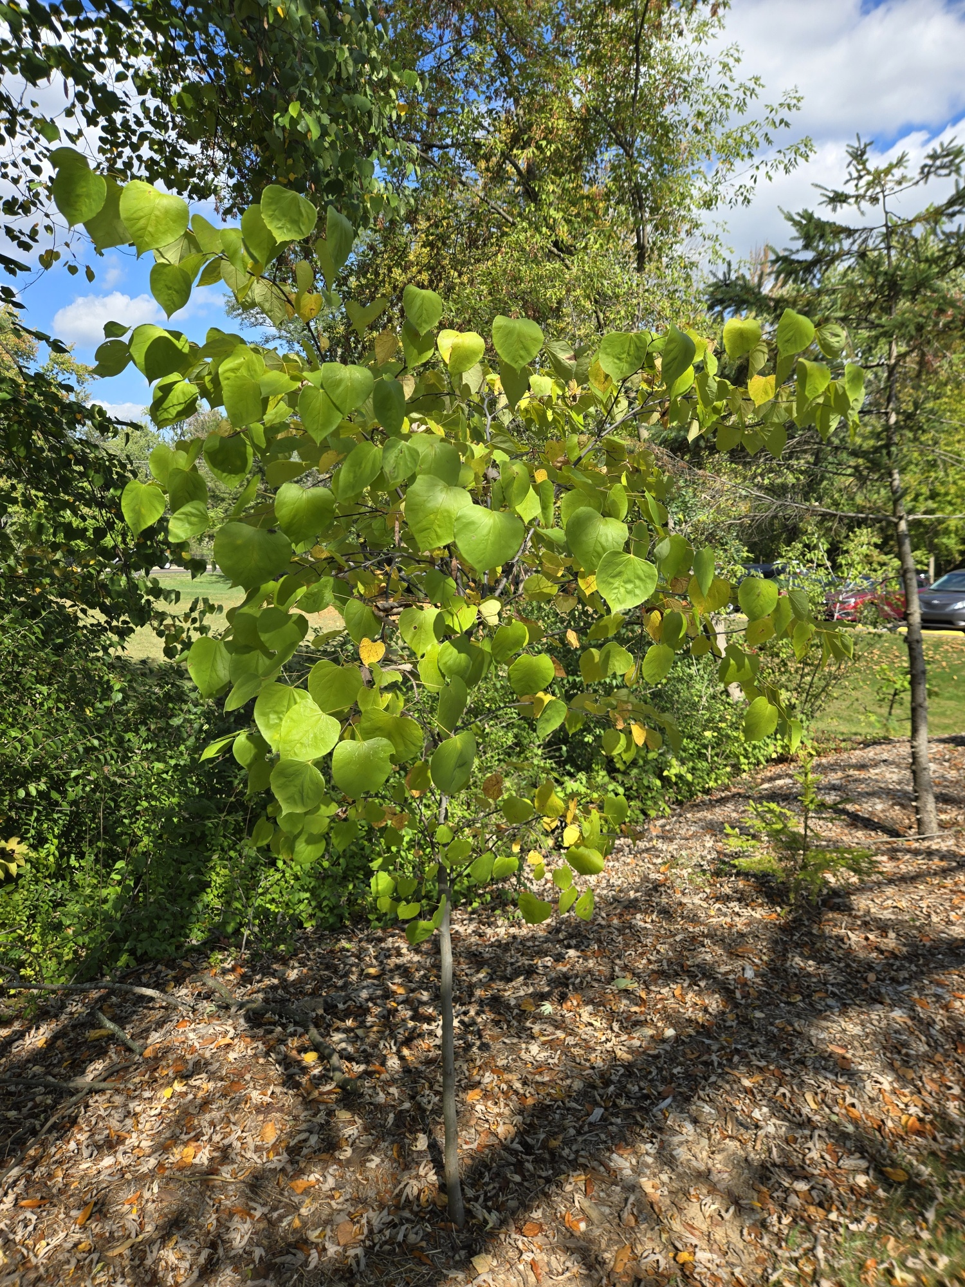
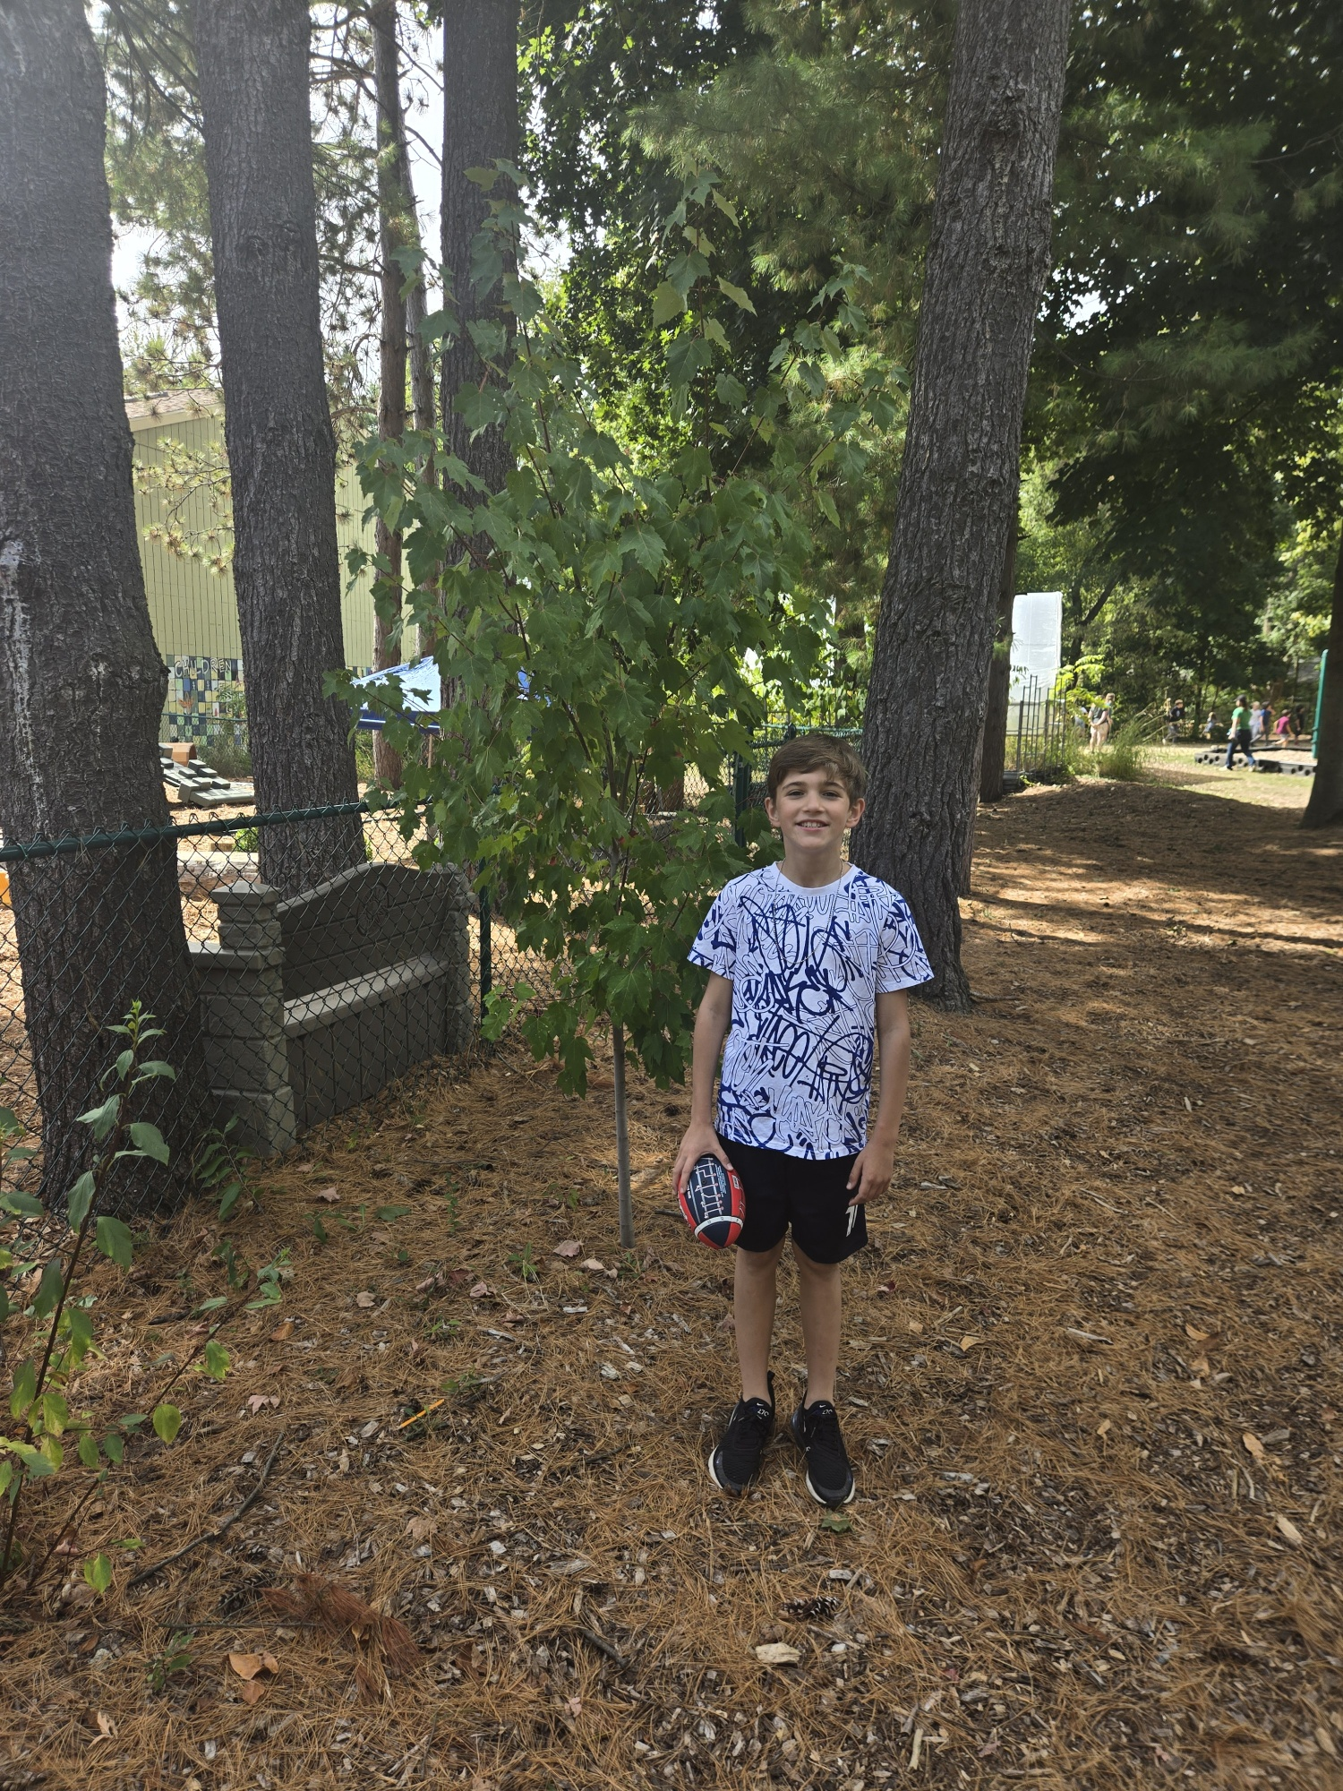
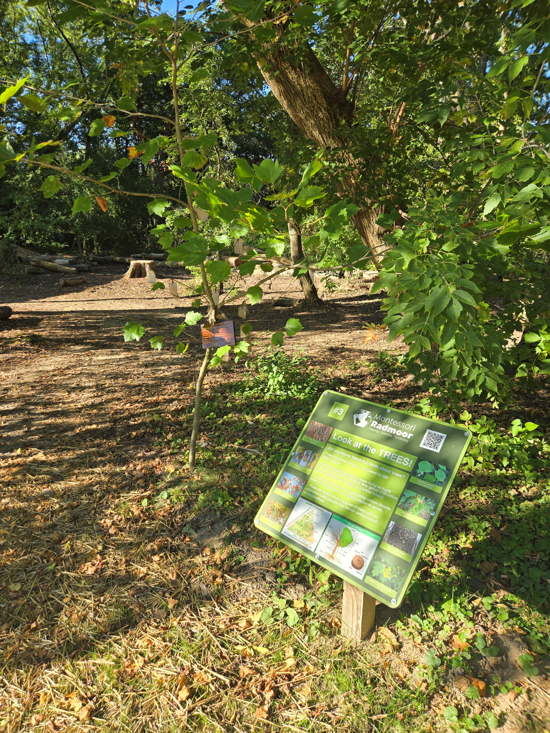
Catalpa
Staghorn Sumac
Bur Oak
Sycamore
Redbud
Red Maple

Slide 24
PART 3
Funds for Table Top CNC Machine
for Student Designed Plant Identification Signs for Native Trees & Plants Along
The Pathway to Discovery

Slide 25

STEP 1: Pick a mature,
native tree along the Pathway
to research
STEP 2: Learn the identifying
features of the tree including
common name, genus/species,
and family
STEP 3: Stain an ID board and
cover for CNC stenciling
STEP 4: Enter the tree facts into
the CNC sign design template
STEP 5: Operate the CNC machine
to etch your facts into your sign
STEP 6: Place the plant ID sign on
the tree

Slide 26
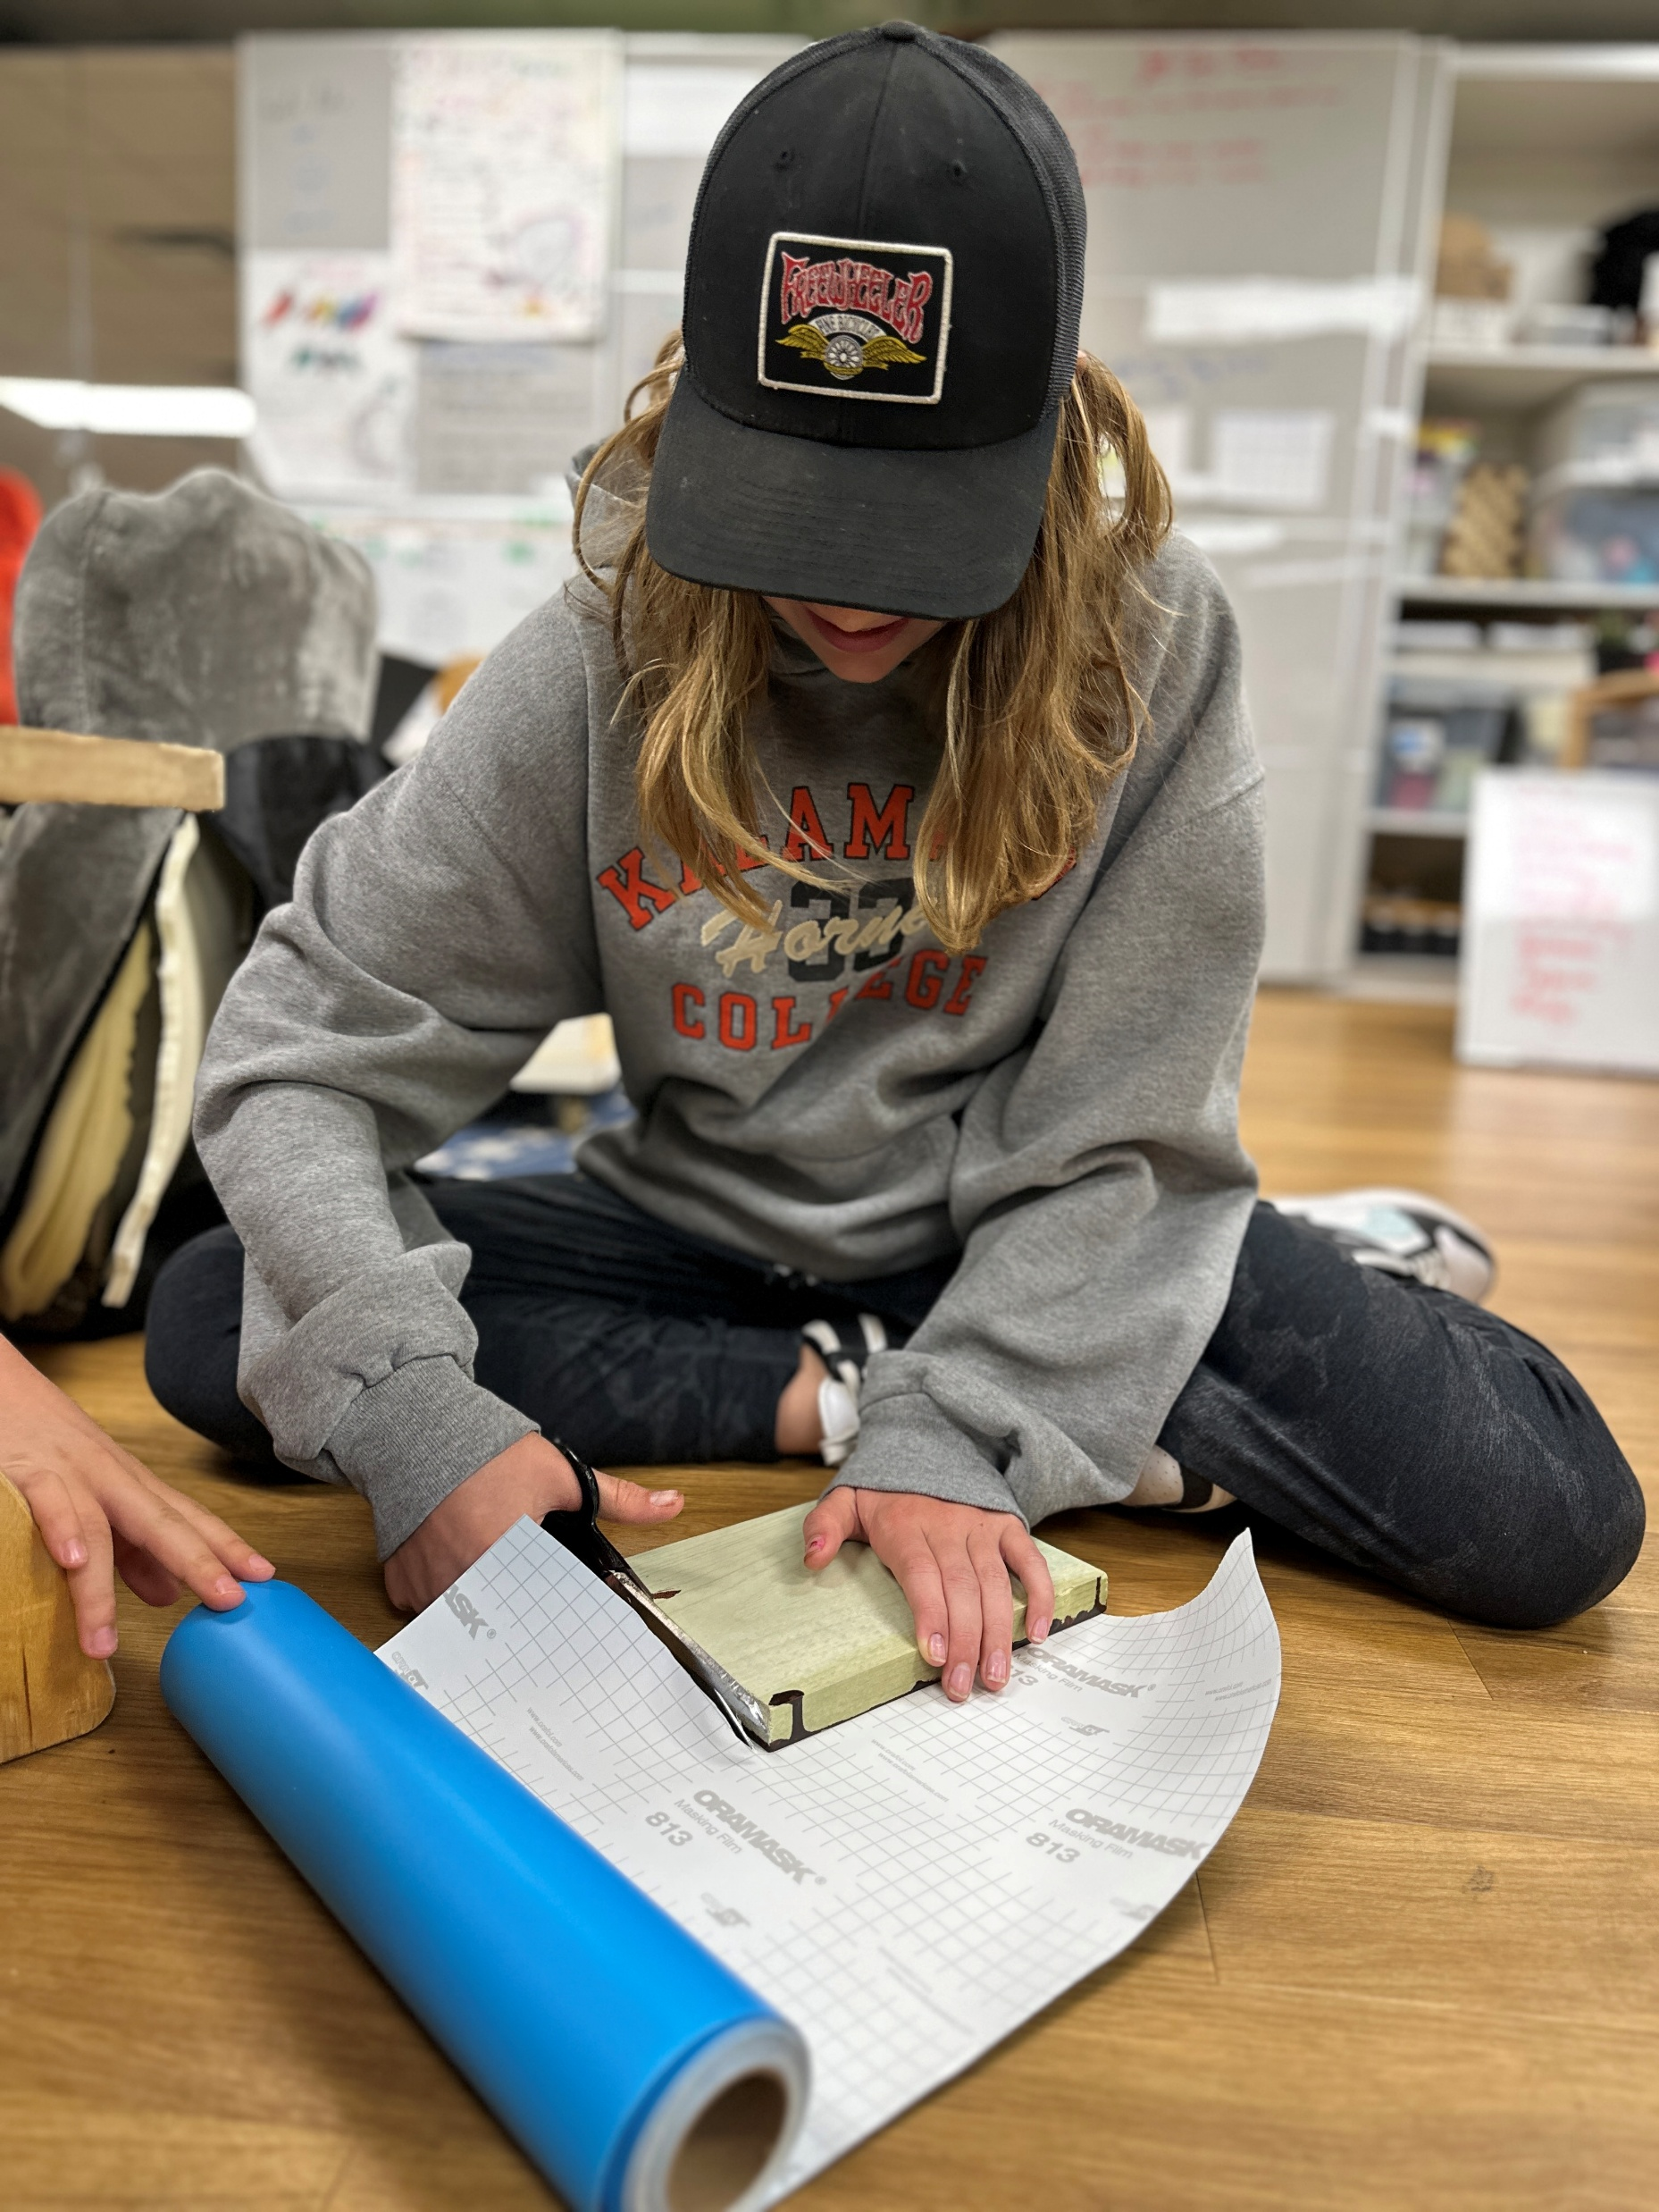
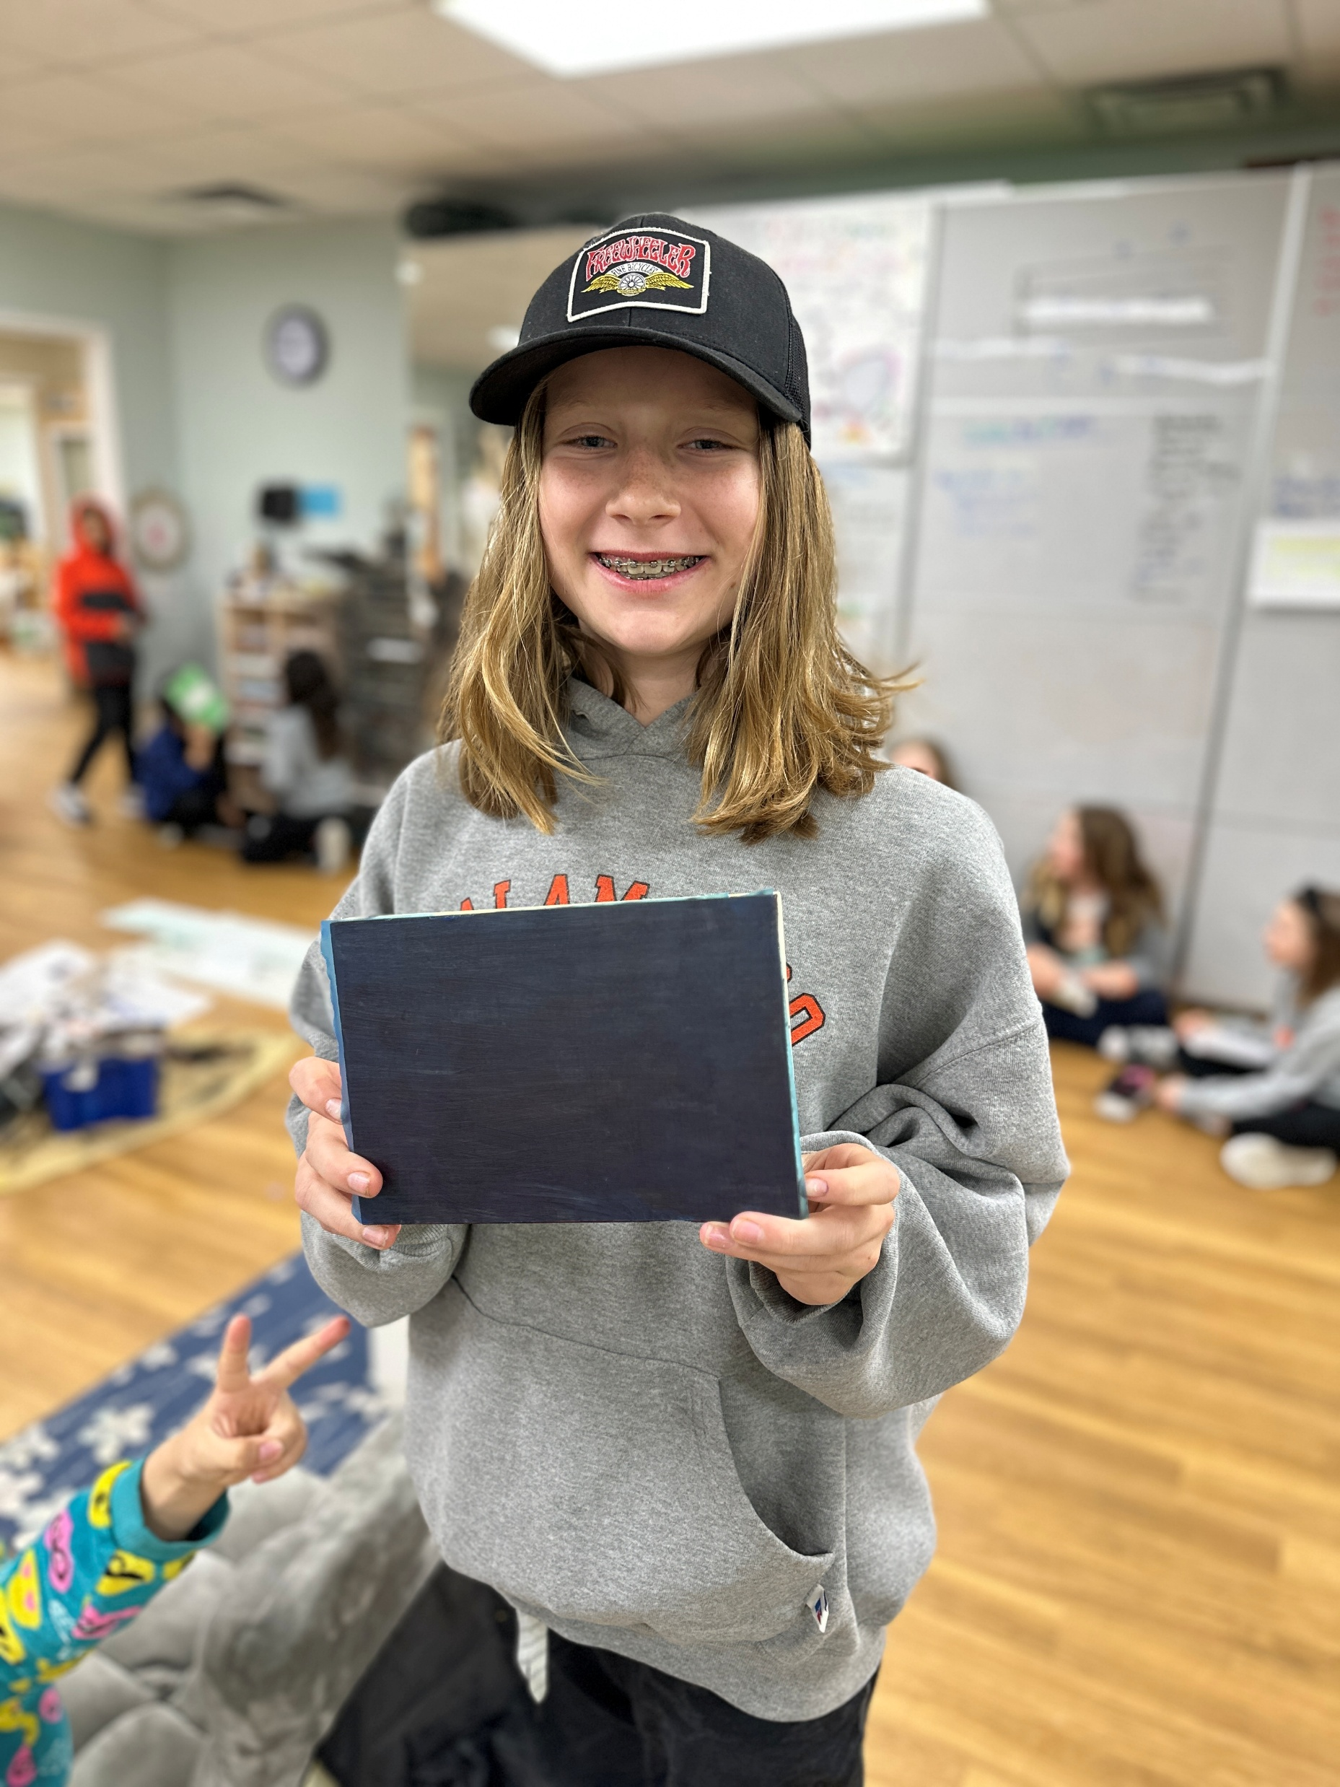
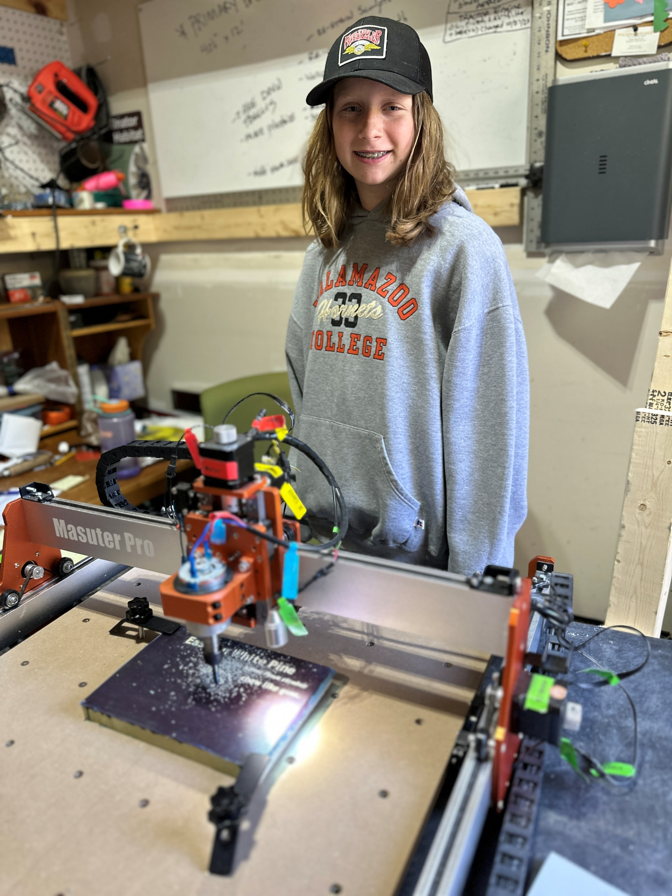
Ready to cut the sign!
CNC Router in action!
Cutting the protective
Stencil paper

Slide 27

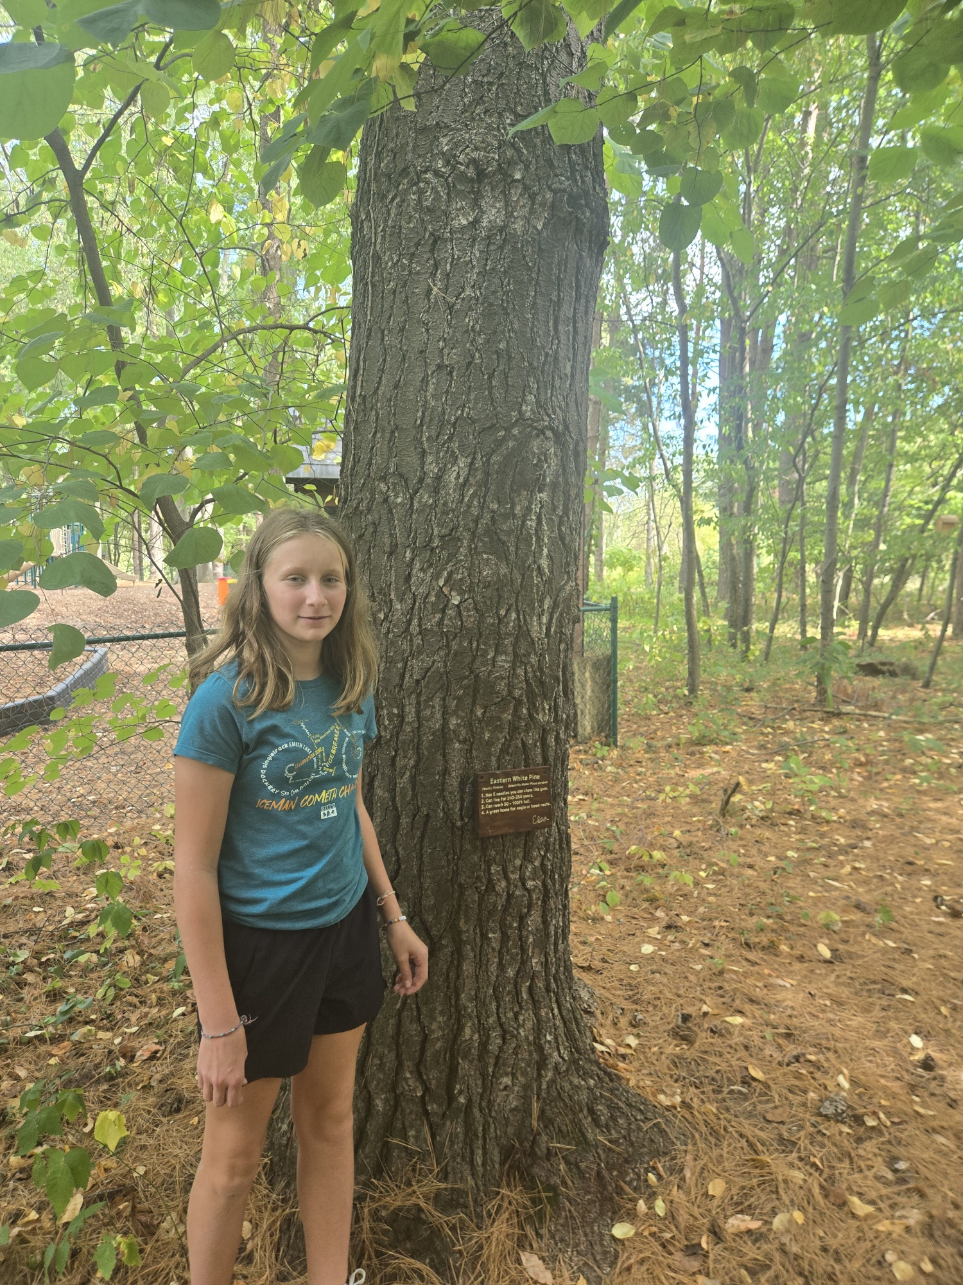
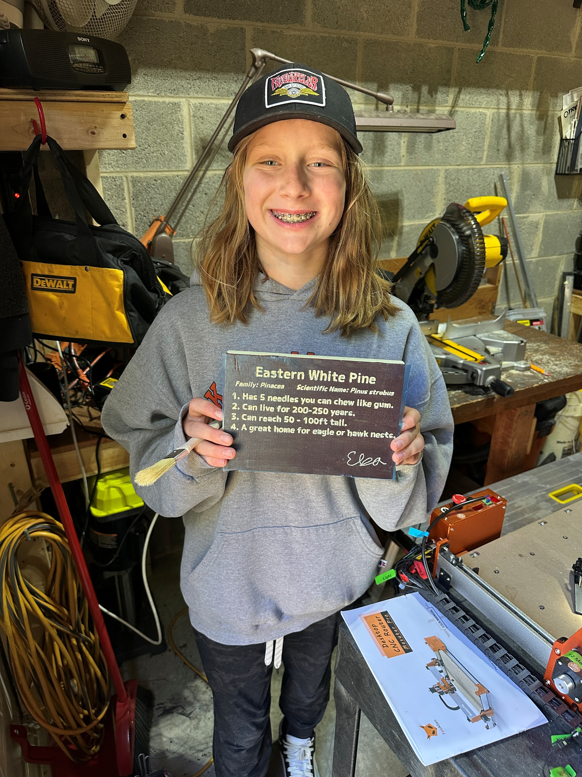
Sign is done!
Elsa & her Eastern White Pine

Slide 28
PART 4
Funds for Fencing and Hardware
For an enclosed Mycology Garden
And Fungi Material

Slide 29
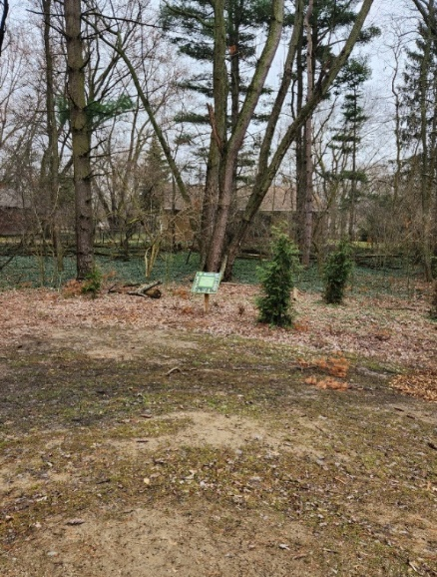

BEFORE
AFTER

Slide 30


Drilling holes in oak logs
Inoculating logs with fungi

Slide 31

Success!!! We have
MUSHROOMS!

Slide 32


Harvesting fungi
Studying results

Slide 33
THANK YOU!!!! ANY QUESTIONS???

