Slide 1
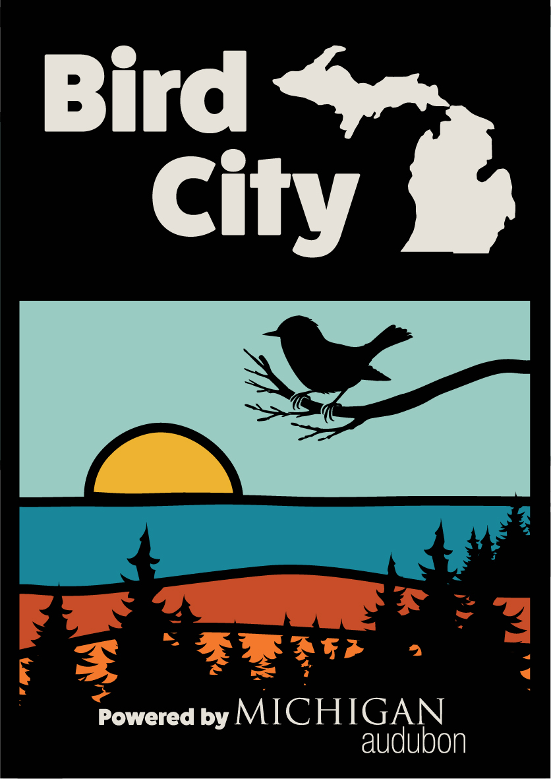
What is a Bird City?
A Bird City is a community (city, village, township, or county) that has been recognized for its work to:
Create and protect habitat
Reduce threats to birds
Educate and engage people
Promote sustainability
Benefits of becoming a
Bird City community
Community Pride, Publicity, Healthier Environment for All
Collaboration amongst like-minded organizations builds a sense of community.
Recognition as a nature-friendly community is good for business.
Launched in January 2025
Jackson Audubon
Notes:
LS…
The goal of Bird City Michigan is to make our environment safer and more welcoming for birds and people by encouraging organizations to work together to learn about threats to birds and to implement solutions.
A Bird City is a community that is recognized with a certification for helping birds and their habitat. Interested communities build a local team and complete an application outlining planned actions in four categories.
There are numerous benefits to the Bird City designation, including increased community pride and enhanced publicity for being recognized as an exceptional steward of the environment.

Slide 2

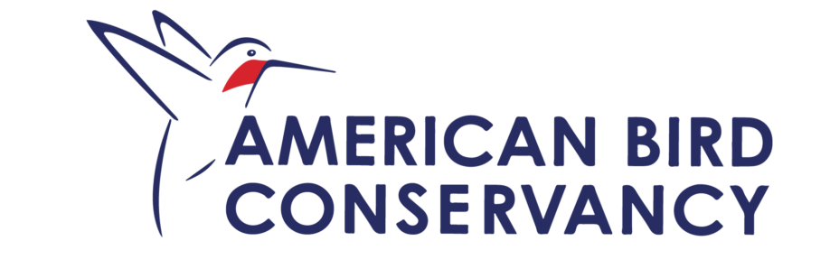

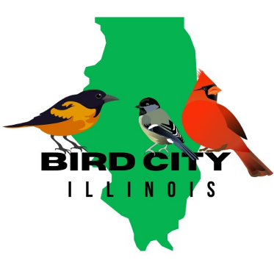
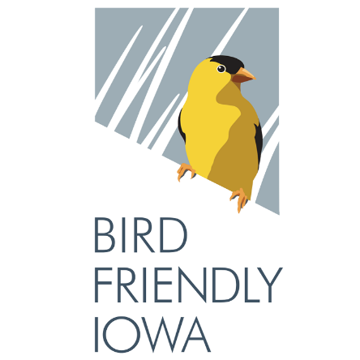
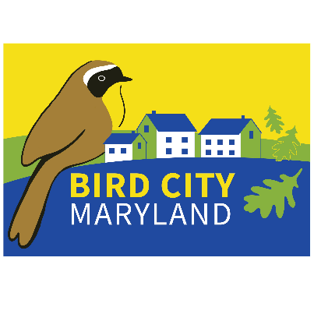
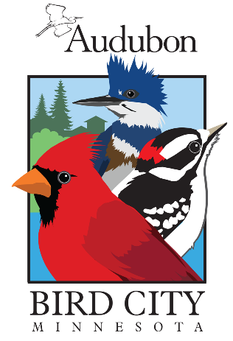
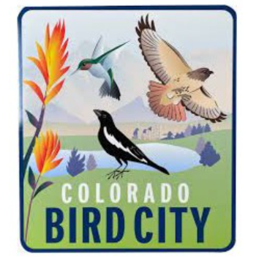
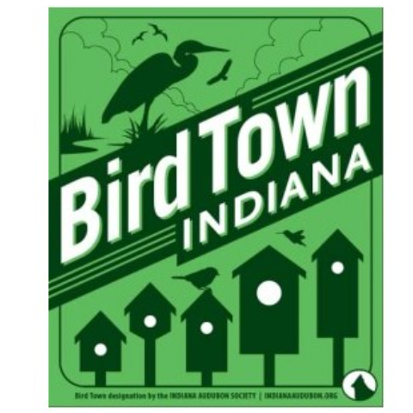



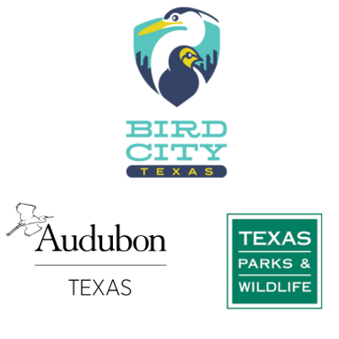
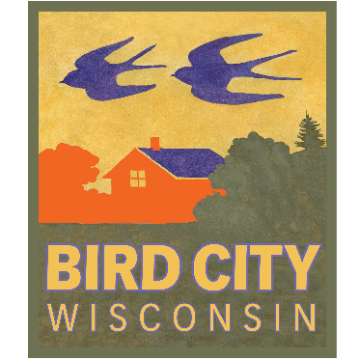
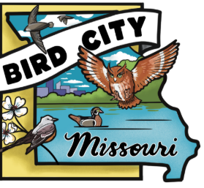
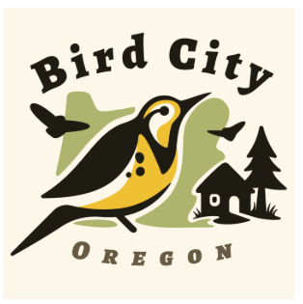

+
=
Bird City Georgia
2009
16 Bird City Programs in the Western Hemisphere.
Over 200 Bird City communities in the Western Hemisphere with over 2,600
bird-friendly actions completed in 2024.
                birdcity.org launched in 2023
Notes:
There are 16 BC programs in the western hemisphere. 13 in the U.S., plus Brazil, Colombia, and Mexico.
Within these 16 programs, there are over 200 communities that have been designated as Bird Cities.
And last year, these 200 communities completed over 2,600 bird-friendly actions.
- You can read all these bird-friendly actions on the birdcity.org.

Slide 3
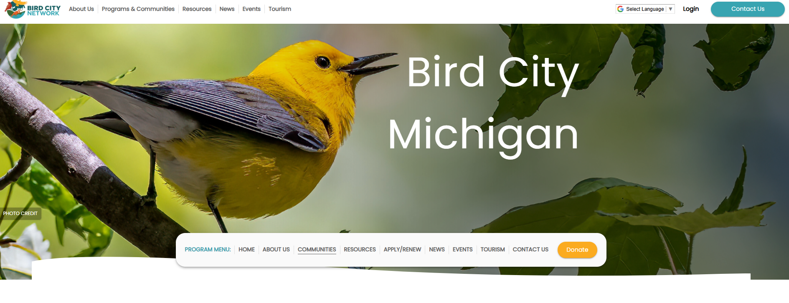
1. Village of Roscommon launched March 17
Team leader: Economic Development Dept.
2. Sterling Heights launched April 2
Team leader: Nature Center
3. Ann Arbor launched April 7
Team leader: Natural Area Preservation
4. Iosco County launched August 8
Team leader: AuSable Valley Chapter
Common Yellowthroat by Michael Stubblefield
Notes:
Bird City Michigan launched in January, and since then we’ve started four BCM communities.
You can read the applications on birdcity.org/Michigan, under the Achievements tab.
And you can see their events on the Events and Tourism tabs.

Slide 4
Examples of Bird-friendly Actions (10 of 90+)
CREATE AND PROTECT HABITAT
Community has created or plans to create a habitat master plan focused on managing natural areas
Educate property owners about invasive plant species and their control
ADDRESS THREATS TO BIRDS
Provide property owners with information on how to protect birds from window strikes
Establish a Lights Out program to reduce collisions during migration
EDUCATE AND ENGAGE PEOPLE
Celebrate World Migratory Bird Day (WMBD) annually
Develop a birding checklist for your area and make it available to citizens and tourist outlets
PROMOTE SUSTAINABILITY
Create a community plan to reduce energy use through building design
Common Yellowthroat by Michael Stubblefield
Notes:
These are some examples of the bird-friendly actions on the application. There are 95 possible actions to choose from, but a community only needs to complete 10 ACTIONS in four categories to be certified as a Bird City.
As I review these, you may recognize that many of the townships current practices will qualify as Action Items, like your Green Initiatives and your Wetland Protection policies.
And when you read through all the 95 possible actions on the application, you may be inspired to start new initiatives to protect bird and wildlife.

Slide 5
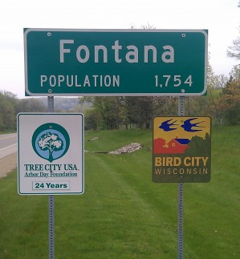
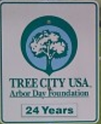
How a community becomes a Bird City
Meridian Township
Form a Team
Like-minded organizations will work together to complete the application: municipalities, birding and nature clubs, schools, nature centers.
Review the list of Actions
Submit the Intent to Apply form
Complete the Application
Choose 10 bird-friendly actions from a list of 95.
The municipality must pass a Resolution to pursue Bird City designation.
Remit the $200 application fee
Common Yellowthroat by Michael Stubblefield
Notes:
The first step is to pull together a team of like-minded organizations that reflect the unique fabric of your location. Potential team members could be leaders of local bird festivals, your local parks and recreation, or a local land conservancy, for example. These are the people who work together to complete bird-friendly actions, help complete the application, and tell your community’s Bird City story.
The team must have at least one person from the municipality, although they don’t need to be the leader of your team.
The second step should be to review the list of Bird-friendly Actions available on the Bird City Michigan page. The application will require only ten actions, and it’s likely that your community is already doing many of these.
The third step is to complete the Intent to Apply form.
The fourth step is for members of your team to work together and complete the application, choosing and documenting the ten actions from the Actions List.
The municipality must pass a resolution confirming their intent to apply for Bird City designation. And remember, a Bird City could be a large or a small community, a city, a village, a township, or a county. The application can be submitted prior to the resolution being passed.

Slide 6
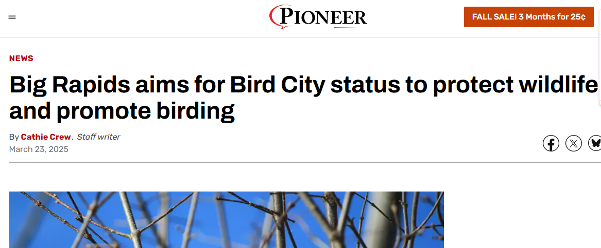
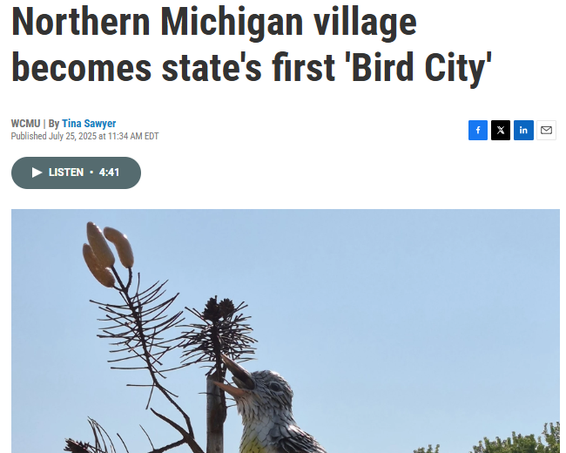
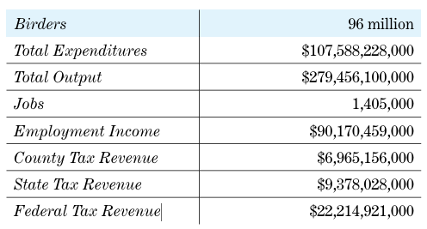
Media Attention
WCMU Podcast June 2025 with Village of Roscommon
Expenditures by birders support jobs and business activity in local economies across the country.
U.S. Fish and Wildlife, 2022
Notes:
One benefit of achieving Bird City designation is media attention that can help you get the word out about the Township’s commitment to protect nature and to maintaining a sustainable and welcoming community. Once Meridian Township is designated as a Bird City, you can post your events and birding hotspots on your BC webpage.
By attracting more nature enthusiasts to your parks and wetlands can translate into business income and revenue for the township.

Slide 7
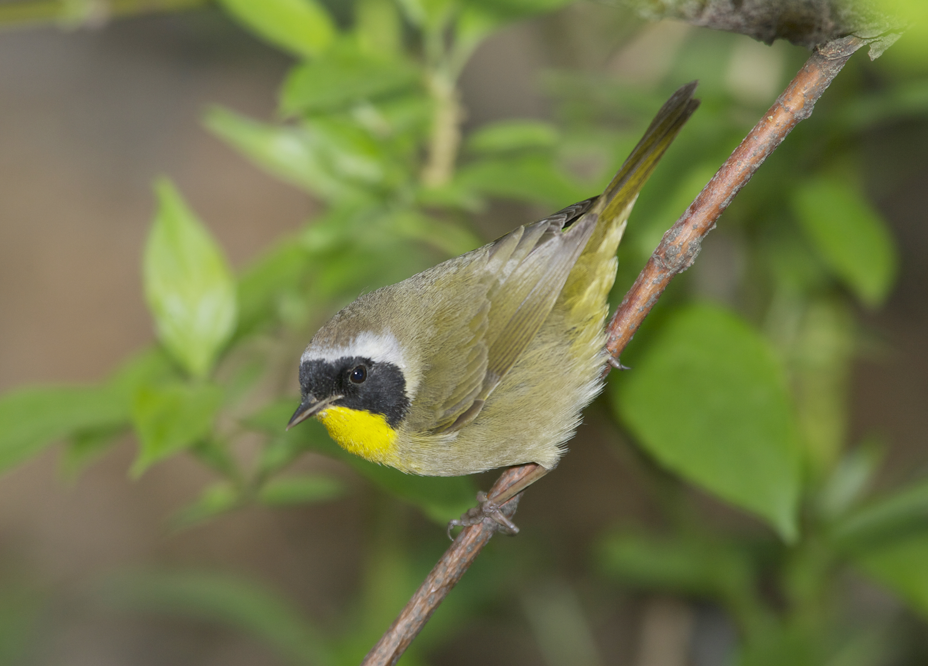

Supporting Documents Available by Request:
How to Become a Bird City in Michigan
Dream Teams Worksheet
Sample Resolution
Intent to Apply
List of over 90 Bird-friendly Actions
Let’s work together and get your community on the Bird City Michigan map!
Linda Smith, Director of Partnerships, Michigan Audubon
lsmith@michiganaudubon.org

